Slide 1
Public Involvement Workshop
Same Day Response Care Delivery Board
Thursday 27 April 2023

Slide 2

Recording
We are recording this session so that we can share the discussion with people who can't attend today's workshop.
Please feel free to switch off your camera if you don't want to be included on the recording.
It will be available on the Same Day Response Care Delivery Board page of the Leeds Health and Care Partnership website shortly.

Slide 3
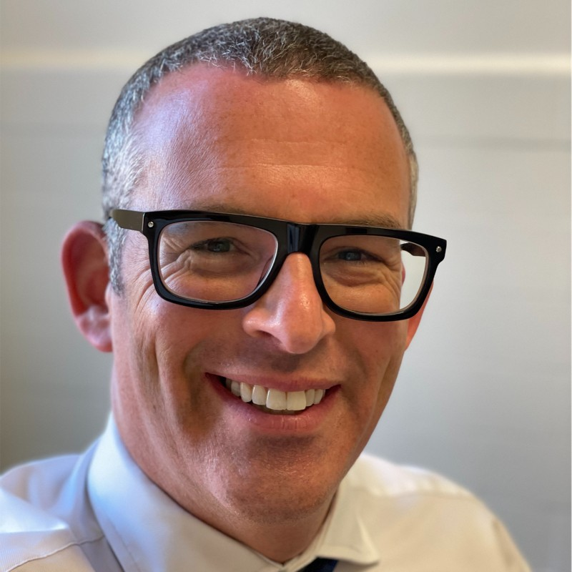
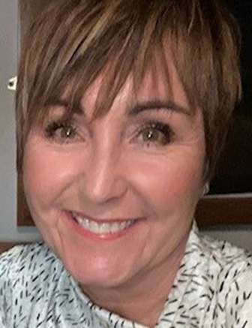
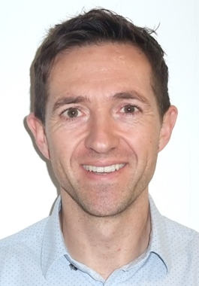
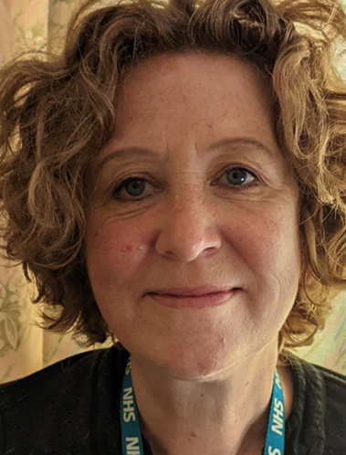
Welcome and introductions
Steve Bush
Chair of the Same Day Response Care
Delivery Board
Gaynor Connor
Director of Primary Care and Same Day Response
Martin Earnshaw
Pathway Integration Leader (Same Day Response),
NHS Integrated Care Board in Leeds
Caroline Mackay
Community Relations & Involvement Manager, NHS Integrated Care Board in Leeds

Slide 4
Aim and outcomes of the workshop
Aim: To share and sense-check our plans for involving local people in the work of the same day response care delivery board
Outcomes – by the end of the workshop you will have:
Had an introduction to the board and its work
Had a chance to discuss the findings of the same day response insight report
Had a chance to discuss gaps in our findings so far
Had a chance to discuss the ambitions / outcomes for the board
Had a chance to discuss public representation and assurance on the board

Slide 5
Agenda
Introduction to the board
Experiences of same day response services - What do we already know about local people's experiences of using same day response services (with a focus on accessing support for urgent, on the day primary care needs)
Outcome measures - Measuring progress and improvement
Public representation and assurance – What does public representation look like on the board, and how can we be assured that it's working?
Next steps - What happens next?

Slide 6

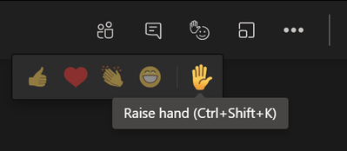
Ground rules
Stick to the agenda
Stay on mute unless you're speaking
Make space for everyone to speak
Have your say – use the hand signal or chat box to ask questions or share comments
Respect confidentiality
Enjoy the session!

Slide 7
Introduction to the Same Day Response Care Delivery Board
Steve Bush – Chair of the board

Slide 8
Population health
Population health moves away from 'traditional' thinking about commissioning (planning and paying for) and providing services.
It thinks less about organisations and pathways and more about people, or 'populations'.
It focuses on:
The needs of people – what is important to people
Prevention – helping people stay well
Outcomes – the difference care makes
Reducing health inequalities
Working as partners rather than as organisations (system working)
The 'wider determinants of health' such as housing and transport
https://www.kingsfund.org.uk/publications/population-health-approach?gclid=EAIaIQobChMI8dWWp_ig-wIVCLbtCh2IKQ7REAAYASAAEgL2w_D_BwE

Slide 9
Population health (2)
How the Leeds population would look if we organised it by need:

Slide 10
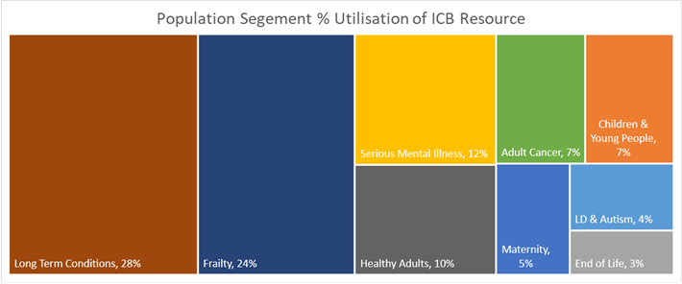
Population health (3)
How the Leeds population would look if we divided it across our nine population boards, showing the level of need and percentage of resource for each.

Slide 11
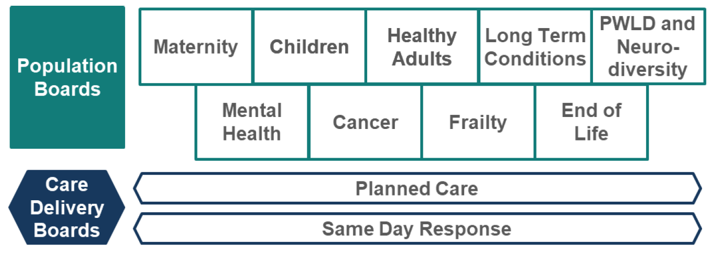
Population health (4)
How are we meeting these needs in Leeds?
These boards are responsible for improving (or driving improvements in) the outcomes, experience and value of NHS spend for their respective population…
They work across organisations, across sectors, and focus on people's needs.

Slide 12
Population health (5)
Same Day Response (SDR) Care Delivery Board:
The SDR Board vision is to ensure everyone in Leeds can access care that is timely, accessible, and best supports their unplanned, same-day care needs.
SDR services include hospital Emergency Departments, ambulance and patient transport services, urgent treatment centres, NHS 111 and clinical assessment service, same day general practice and general practice out of hours, walk in centres, urgent community response, same day response mental health services and same day response children’s services,.
When considering the SDR population – we start with a set of service definitions, and then look at the population using them.

Slide 13
Population health (6)
The purpose of the SDR Board is to:
Provide strategic and operational oversight of the delivery of the SDR Programme.
Develop and oversee short and long term sustainable and effective services that respond to on the day demands of the diverse population of Leeds.
Improve the outcomes, experience, and value of NHS spend in Leeds on behalf of the Leeds Health and Care (Place Based) Partnership Integrated Care Board (ICB).
Take action to reduce health inequalities through overseeing the delivery of the aspects of the Healthy Leeds Plan that are relevant to this board.
Drive and oversee the delivery of nationally mandated priorities as they apply to this board.
Utilise Population Health Planning and Management approaches to ensure the Leeds pound is used effectively to achieve value-based care for people in Leeds.
Understand and support capacity and demand as well as unmet need for services and pathways in scope through the application of Population Health Management tools and methods.
Work closely with the Population Boards (Children, Mental Health, Healthy Adults, Long Term Conditions, Frailty, End of Life) to support their respective outcomes frameworks.

Slide 14

Getting boards “just right”
.
Broad enough (to represent all partners)
Senior enough (to take critical decisions)
Small enough (to make these decisions)
Arthur Rackham, from English Fairy Tales by Flora Annie Steel, 1918 (Project Gutenberg)
Notes:
Boards are made up of senior representatives from across the health and care partnership including representatives from the third sector and from Healthwatch Leeds.
There is also space for 'citizen' or people's voice representation, which we are thinking about today

Slide 15
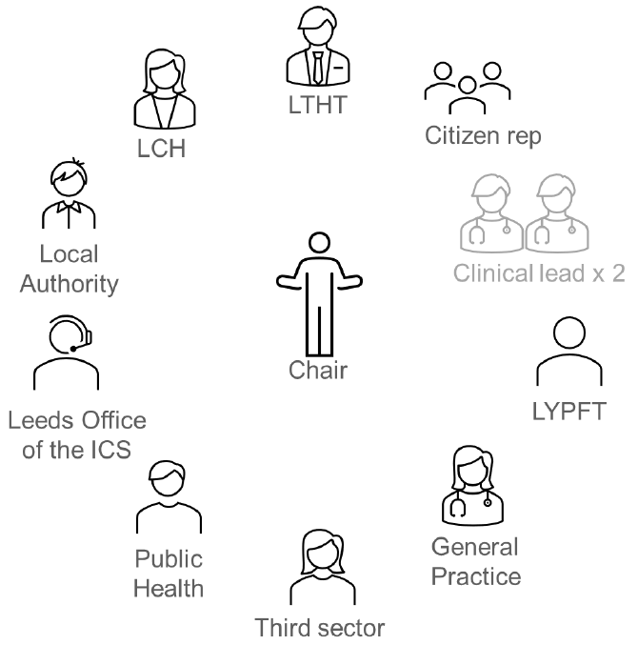
The make up of the board
Leeds Teaching Hospitals NHS Trust
Leeds Community Healthcare NHS Trust
Leeds and York NHS Partnership Foundation Trust
Leeds office of the NHS West Yorkshire Integrated Care System
Also includes Healthwatch Leeds as a non-voting member
Notes:
Boards are made up of senior representatives from across the health and care partnership including representatives from the third sector and from Healthwatch Leeds.
There is also space for 'citizen' or people's voice representation, which we are thinking about today

Slide 16
What kinds of decisions do we make?
How to bring different bits of the system together to get the best for people
How to work with other boards (managing overlap)
Discussing & supporting new initiatives
Looking at what can be done to address health inequalities
Notes:
It is essential that local people's views are included in these decision-making processes.
This workshop builds on what we have learned so far about people's experiences of living with frailty in Leeds, and gives us an opportunity to begin to think about what how we can involve people more moving forward.

Slide 17
Examples of things we’ve achieved
Developed a draft outcome framework
Developing a new integrated secondary and community care coordination hub which aims to increase the number of patients who access the ‘right’ unplanned same day care first time.
Commissioned additional same day primary care service aiming to meet on the day patient demand/need
Launched a new community Paediatric Respiratory Hub offering same day appointments for children/young people with respiratory illness
Development and promotion of ‘Healthier Together’ – a WY resource which provides clinical guidance online for parents
Notes:
Improving Access to Services / PCAL+
24/7 Integrated Primary Care Services
Urgent Treatment Centres Strategy and Development
In-Hospital Strategy and Development
Same Day Mental Health and Crisis Response
Same Day Response for Children
Same Day Urgent Community Response

Slide 18
Experiences of same day response services –
Using local people's experiences of same day response services to help shape and improve services in the future.
Caroline Mackay

Slide 19
Experiences of same day response services
The board is working with citywide partners to establish a developing evidence base of the needs and preferences of people using these services, to help make more informed decisions about their treatment and care.
The Leeds same day response insight report:
Outlines what we already know about people's needs, preferences and experiences of same day response services in Leeds
Identifies key themes and highlights what matters most to people, their families and carers
Highlights gaps in our knowledge or understanding

Slide 20
Experiences of same day response services (2)
The insight report highlights some key themes:
Information - Further information and clarity on the different services available for urgent and emergency care, would be helpful. Some people are unclear about where they should go to seek help.
Health inequality – Same day response services should be accessible to everyone, including those from diverse communities such as those who require interpreters or information in different languages or formats.
Health inequality - Digital has a role to play in providing information, signposting to appropriate services and in some cases negating the need for face-to-face appointments, but uptake is uneven and is affected by factors including age and socio-economic position.
It is worth noting that most people completing feedback surveys are satisfied with their experience of same day care services, but some groups consistently report poorer experiences (www.cqc.org.uk/publications/surveys/urgent-emergency-care-survey-2020 )

Slide 21
Experiences of same day response services (3)
  Gaps in what we know
  In relation to gaps in our knowledge or understanding, this workshop is part of our work to learn from those with experience of same day response services about where we may need to do further work to learn more.
  One gap we are aware of, is a lack of feedback from staff delivering same day response services.

Slide 22
Experiences of same day response services (4)
The Same Day Response board covers a range of urgent and emergency services in Leeds.
The main focus for our conversations today is on accessing support for urgent, unplanned and on the day primary care needs.
These services can be accessed by:
calling your own GP practice,
calling NHS111, or
visiting a walk-in or urgent treatment centre for a minor illness or injury.
Urgent care is provided for an illness or injury that requires urgent attention but is not a life-threatening situation. Urgent care services in Leeds include Urgent Treatment Centres, Out of Hour GP services, and same day response mental health services.

Slide 23

Experiences of same day response services (5)
Discussion space
Do you agree with the main themes highlighted so far (information and health inequality)?
What matters most to people?
What about gaps… where else should we be looking for insight, or who else should we be hearing from?

Slide 24
Outcome measures –
How will the board know it's making progress with its goals and ambitions?
Martin Earnshaw

Slide 25
Outcome measures
  Over the past year we have been working with our partners to agree a set of outcomes (or goals) for our same day response work in Leeds.
  These outcomes explain what we as a board, and as a health and care partnership, want to achieve to improve the experiences of people receiving same day response care, and their families and carers.
  The outcomes have been developed with healthcare service providers and voluntary sector organisations that work alongside people using same day response services and support.
  The outcomes were shaped using patient, carer, family and staff feedback from various surveys and involvement activities.

Slide 26
Outcome measures (2)
The outcomes (or goals) for the same day response board's work in Leeds are:
People are easily able to access the service that can provide the most responsive and appropriate care to meet their unplanned same day needs.
People’s same day care needs are met wherever they present (if possible), and where they need to be cared for elsewhere, this feels seamless and integrated.
Care is high quality, person-centred, and appropriate to people’s same day care needs now, whilst considering how these might change in the future.

Slide 27
Outcome measures (3)
We will use a range of measures to demonstrate our progress against these goals. These include:
Outcome 1 - Proportion of visits resulting in an onward referral (to a service that could have been accessed directly)
Waiting times – booking vs seen, GP access
% direct booking from 111 into services
Increased number of self / carer referrals to urgent community response
Proportion of face to face appointments vs telephone with GP
Outcome 2 - Number of ‘repeated’ visits to same-day services for same complaint
Proportion of patients re-directed from Emergency Department (ED) to other unplanned care services
% Yorkshire Ambulance Service attendances, via 111, that could have gone somewhere other than ED
% activity within community venues
Outcome 3 - Emergency Department waiting times
Initial contacts and % 2hr crisis response

Slide 28
Outcome Measures (4)
Discussion space
Do these outcomes make sense / sound right to you?
People are easily able to access the service that can provide the most responsive and appropriate care to meet their unplanned same day needs.
People’s same day care needs are met wherever they present (if possible), and where they need to be cared for elsewhere, this feels seamless and integrated.
Care is high quality, person-centred, and appropriate to people’s same day care needs now, whilst considering how these might change in the future.
Do they reflect what matters to you / your family / the people you represent?

Slide 29
Public representation and assurance –
Working to put local people and their experiences of same day response care at the heart of the board's work.
Caroline Mackay

Slide 30
Public representation and assurance
As an organisation, we have a legal and a moral duty to involve people in the plans and decisions we make about delivering healthcare in Leeds.
It's important that patients, carers and the wider public are aware, and assured, that we are working to ensure that people's voices and experiences are at the heart of our decision-making, and that people feel that their voices and experiences are being properly represented.
We need to be able to show that this is happening so that people can be assured that their input and feedback is helping shape and improve local services and support.
We call this providing 'public assurance'.

Slide 31
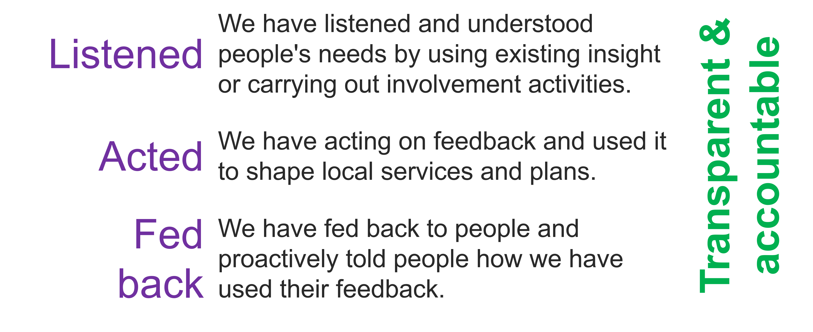
Public representation and assurance (2)
For people to feel assured we need to demonstrate we are:

Slide 32
Public representation and assurance (3)
There are various ways people's voice and experience can be taken into account by the board:
By an individual
By a sub-group which runs parallel to the board
By links with an existing group or organisation
By increasing feedback to services directly
Our work to strengthen public assurance is ongoing – today we are keen to hear your thoughts on how the voices and experiences of people using same day response services, and their families and carers would be best represented at the board.

Slide 33
Public representation and assurance (4)
Discussion space
What would good public representation look like for you?
What would make you feel confident that we are listening, acting and feeding back?

Slide 34

Any final thoughts or questions?

Slide 35
Next steps
We plan to add a copy of this recording to the same day response webpage:
https://www.healthandcareleeds.org/have-your-say/shape-the-future/populations/same-day-response/
We will send out the slides and an evaluation survey of this workshop
We'll use today's feedback to update the insight report where appropriate
We'll use today's feedback to help develop our approach to representation
We'll begin looking at the gaps in our knowledge and think about involving people to help us learn more. Please send any additional insight or comments to caroline.mackay2@nhs.net
We'll organise a follow-up public involvement meeting to talk more about public representation and assurance.

Slide 36
Thank you
Thank you for your time and your contribution – it's very much appreciated!

