Slide 1
Public Involvement Workshop
Planned Care
March 2023

Slide 2

Recording
We are recording this session so that we can share the discussion with people who are unable to attend the meeting.
It will be available shortly on the Leeds Health and Care Partnership Website

Slide 3
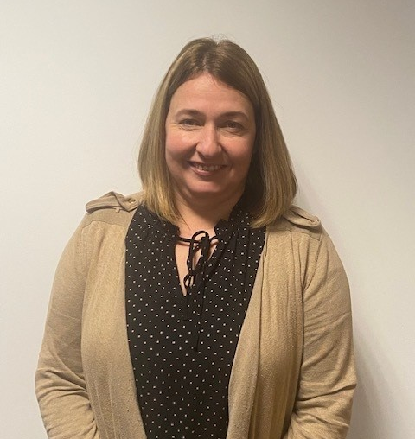
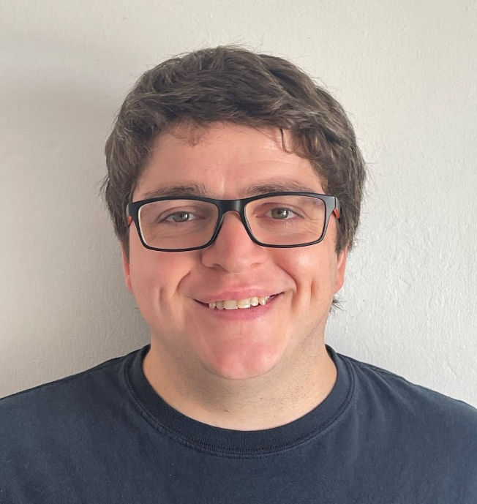
Welcome and Introductions
Stuart Murdoch
Chair of the Planned Care Delivery board
Joanna Bayton-Smith
Head of Pathway Integration for Planned Care, Cancer and Diagnostics
Adam Stewart
Senior Insight, Involvement and Engagement Advisor, NHS ICB in Leeds

Slide 4
Aim and objectives
Aim
To develop our approach to public involvement in the population board
Objectives
Introduce population health and the board
Review and agree the findings of the insight report
Review and agree the draft outcomes for the board
Begin planning involvement on the gaps in our knowledge
Agree how we represent people at the board and provide public assurance

Slide 5
Outcomes of the workshop
By the end of the workshop participants should have had an opportunity to:
Understand the role of the board
Discuss the findings of the draft insight report
Influence the draft insight report
Discuss gaps in our knowledge
Suggest other gaps
Discuss the draft outcomes for planned care
Explore ways we can provide assurance that people's voices are heard at the board
Influence our approach to public representation and assurance on the board

Slide 6
Agenda
Population Health - What are population and care delivery boards and what is their role?
Experience of planned care - What do we know about the experiences of people using planned care services and their family? (our insight)
Population outcomes - How do we want things to be different for people using planned care services and their families? (our outcomes)
Public representation and assurance – What does public representation look like on the board?
Next steps - What happens next?

Slide 7
Ground rules
Stick to the agenda
Be honest
Be open to new ideas
Listen to others
Respect confidentiality
Don’t judge
It's ok to ask for clarification and confirmation
Don't zoom and drive
Enjoy

Slide 8
Population health
Population health moves away from 'traditional' thinking about commissioning (planning and paying for) and providing services.
It thinks less about organisations and pathways and more about people, or 'populations'.
It focuses on:
The needs of people – what is important to people
Prevention – helping people stay well
Outcomes – the difference care makes
Reducing health inequalities
Working as partners rather than as organisations (system working)
The 'wider determinants of health' such as housing and transport
https://www.kingsfund.org.uk/publications/population-health-approach?gclid=EAIaIQobChMI8dWWp_ig-wIVCLbtCh2IKQ7REAAYASAAEgL2w_D_BwE

Slide 9
Population health (2)
How the Leeds population would look if we organised by need.

Slide 10
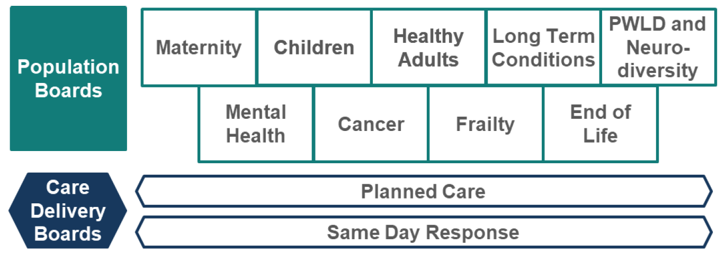
Population health (3)
How we will meet these needs in Leeds?
These boards are responsible for improving (or driving improvements in) the outcomes, experience and value of NHS spend for their respective population…
Working across organisations, across sectors, and focussed on people's needs.

Slide 11
Population health (4)
Planned Care Delivery Board scope:
Planned care is also known as ‘elective’ care.
It is treatment that people have to help manage a health problem, rather than emergency treatment for an urgent medical condition, or following a serious accident for example.
Planned care refers to the different stages of someone’s medical journey which covers being referred, receiving treatment, having tests, and sometimes an onward management plan
People are usually referred for planned care by a GP or another healthcare professional.
Planned care refers to services for pre-arranged health appointments either in a community setting or in hospital
Planned care can cover many different medical procedures including joint replacements and cataract surgery as well as the management of conditions in community settings.
It also includes diagnostics which are tests that are carried out to detect diseases such as cancer and other serious medical conditions.
Most planned care procedures are done as day cases, where patients leave hospital on the day of the procedure. Sometimes patients have to stay in hospital overnight or a bit longer if necessary.

Slide 12
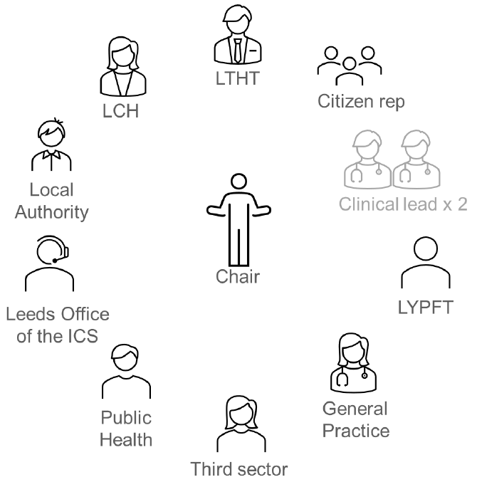
Population health (5)
Boards will be made up of senior representatives from across the health and care partnership.
The boards will be
Broad enough (to represent all partners)
Senior enough (to take critical decisions)
Small enough (to make these decisions)

Slide 13
Population health (6)
What sort of decisions will the boards make?
Where to allocate funding
When to make changes to services
What the priorities are
How to deliver value (value for money)
It is essential that we involve people in this decision-making process. This workshop builds on our involvement so far and gives us an opportunity to plan future involvement together.

Slide 14
Experience of planned care
In Leeds we want to commission (plan and pay for) and provide care that is:
Safe
Sustainable
Patient-centred
Value for money
We cannot do this without understanding the needs, preferences and experiences of people in our population.
We are committed to 'starting with what we know' about people's experiences and engaging on the gaps in our knowledge.

Slide 15
Experience of planned care (2)
Each population and care delivery board in Leeds is working with partners to review what we already know (an insight review). Our findings will be written into an insight report which will be used by the board to understand the needs of the population and make decisions.
The insight report will:
Look at what we already know about people's needs, preferences and experiences
Identify the key themes (the things people often tell us about their care)
Highlight the gaps in our knowledge (the areas or communities we know least about)

Slide 16
Experience of planned care (3)
Our insight review for planned care suggests the following themes:
Person-centred care is very important to people and there are a number of examples of how this could be achieved to develop planned care. This includes:
    Being flexible in how services work with people.
    Tailoring communication methods / needs where necessary.
    Listening to a person’s concerns and genuinely considering them.
    Working with the patient’s carers / family as equal members of the discussion.
    Being patient and accommodating with the needs of different people and communities.
    Working to ensure that patients feel fully involved and informed about their care.
    Ensuring patients have the right information to understand their situation, including how they might feel based on potential stigma about conditions / treatments
People want communication to be clear, efficient, and not make assumptions that people know how services work. This means communicating in a clear, accessible, plain English way to ensure that people are fully informed about their care at all stages.

Slide 17
Experience of planned care (4)
Our insight review for planned care suggests the following themes:
People noted poor communication when on long waiting lists and noted how important it is to be ‘kept in the loop’ with updates to provide reassurance that they haven’t been forgotten.
People want to see helpful information produced and made available to people. This could include:
    Supportive information ahead of an appointment / treatment and then follow up information about how to stay well and what to look out for (signs of deterioration / medication side-effects etc.).
    Available in different formats would be helpful (such as videos / available online etc.), including alternative accessible formats and languages as needed.
People have told us about the importance of the workforce in and how the staff often make the biggest difference to someone’s outcome.
It is important that people have a choice as to how they access appointments and care (face to face or digital, for example).
Services must treat and consider the whole person, ensuring that needs generated from the differences of who they are (such as race, age, sexuality etc.) are not missed / ignored (health inequality / person-centred).
People have told us that they want to see joint working from all health and care services (regardless of who they are).

Slide 18
Experience of planned care (4)
Our insight review for planned care suggests the following gaps:
Local patient experience feedback from services that deliver planned care activities, including:
    Leeds Teaching Hospitals NHS Trust
    Leeds Community Healthcare NHS Trust
People from diverse ethnic communities.
People from areas of deprivation in the city.
People from LGBTQIA+ communities.
People who are considered homeless.
We know that there are some people who do not believe services are for them and are disengaged from services (for example not registered with a GP practice).
Working age adults
Carers
People who are offline
Feedback from people who have served in the armed forces.

Slide 19

Experience of planned care (5)
Groupwork
Do you agree with the themes and gaps?
Have we missed any themes or gaps in our insight?
How do we prioritise and plan involvement work on the gaps?

Slide 20
Population outcomes
Over the last year we have been working with our partners to agree a set of outcomes for planned care in Leeds. These outcomes explain what we want to achieve to improve the lives of people using planned care services and their carers, family and friends.
The outcomes have been developed with service providers and voluntary sector organisations that represent people using planned care services. The outcomes were shaped used patient, carer, family and staff feedback from various surveys and involvement activities.

Slide 21
Population outcomes (2)
Outcomes for planned care in Leeds
Planned care services are accessible to all regardless of who they are.
People are supported whilst waiting for planned care services.
People agree appropriate and realistic shared health goals, and actively participate in their achievement.
Each outcome has a set of 'measurables'. These are things we will use to measure whether we have achieved our outcomes.

Slide 22
Population outcomes (4)
Groupwork
Do you understand these outcomes?
Do the outcomes reflect what matters to you / your family / the people you represent?
How do you think we can best demonstrate improvements against these outcomes?

Slide 23
Public representation and assurance
We have a legal and a moral duty to involve people in the decisions we make.
We want patients, carers and the public to be assured that we are putting people at the heart of our decision-making. We call this approach 'public assurance'.

Slide 24
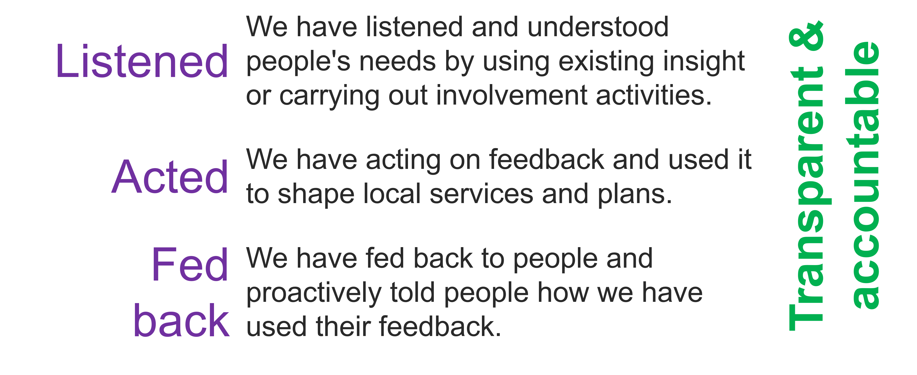
Public representation and assurance (2)
For the public to feel assured we need to demonstrate we have:

Slide 25
Public representation and assurance (3)
There are lots of ways we provide assurance that we have involved people in our work:
Insight reviews
Insight reports
Workshops
We want to continue and build on our public assurance work. This will involve working with our partners and local people to create new ways to represent the views of patients, their families and staff on our boards.

Slide 26
Public representation and assurance (4)
Groupwork
What do you think of the ways we are already involving people (insight reviews / workshops)?
What does public representation look like for you?
What would make you feel confident that we are listening, acting and feeding back?

Slide 27
Next steps
Evaluation of the session
Update insight report based on todays feedback
Use feedback to develop an approach to representation
Begin planning involvement on the gaps in our knowledge

Slide 28
Thank you

