Slide 1
Public Involvement Workshop
Learning Disability and Neurodivergence
March 2023

Slide 2
Recording
We are recording this workshop.
It means we can share the video with people who aren't here.
You'll find it on the Leeds Health and Care Partnership Website

Slide 3
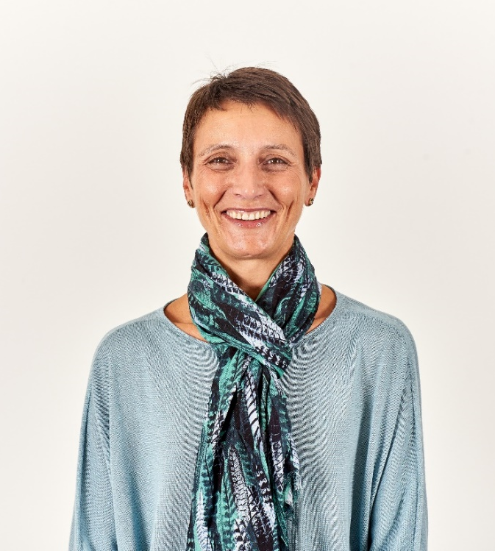
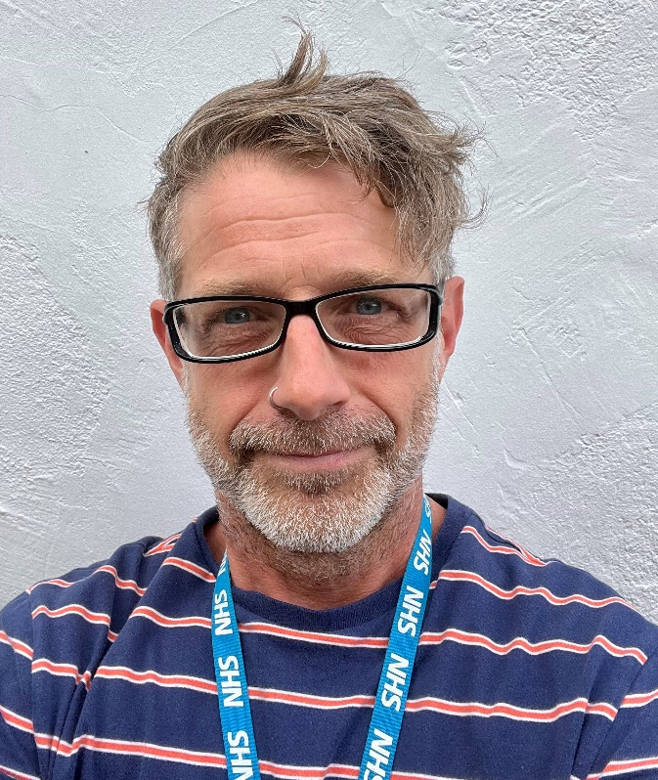
Welcome and Introductions
Sam Browning
Clinical Lead for Learning Disability and Chair of the Learning Disability and Neurodiversity Population Board
Eddie Devine
Head of Pathway Integration Lead for the Learning Disability and Neurodiversity and Mental Health Population Boards
Chris Bridle
Senior Communications and Involvement Manager
NHS ICB in Leeds

Slide 4
Aim and objectives
Aim
To develop our approach to public involvement in the population board
Objectives
Introduce population health and the board
Looking at what people have told us
Look at the goals for the board
Try to find out what we don't know
Talk about how we make sure people are involved

Slide 5
Outcomes of the workshop
Understand the role of the board
Talk about what people have told us
Talk about gaps in our knowledge
Talk about the goals for learning disability and neurodivergence
Talk about how we can involve people in the board

Slide 6
Agenda
Population Health - What are population health boards and what is their role?
Experience of learning disability and neurodivergence care - What do we know about the experiences of people with a learning disability, neurodivergent, or both, and their family?
Population outcomes - How do we want things to be different for people with a learning disability, neurodivergent, or both, and their families?
Public involvement – What does this look like on the board?
Next steps - What happens next?

Slide 7
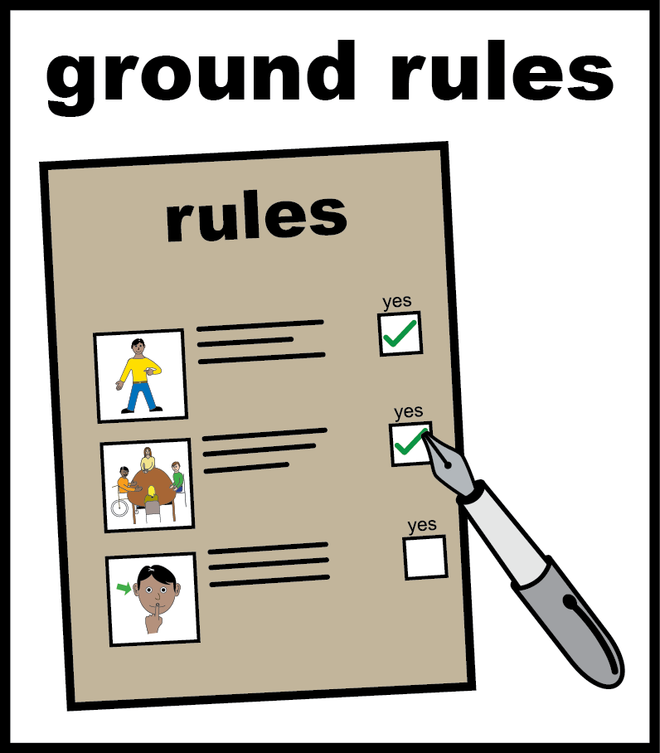
Ground rules
Stick to the agenda
Be honest
Be open to new ideas
Listen to others
Respect each other
Be as involved as you want to
Don’t judge
It's ok to ask if you're not sure about something
Don't zoom and drive
Use the chat if you want to
It's ok to leave if you want to (you don't have to tell us)
Have fun!

Slide 8
Population health
Population health is a different way of planning health and care services. It's a change from what we've done before.
It's less about organisations and more about people. We call groups of people in population health: 'populations'.
It looks at:
The needs of people – what is important to people
Prevention – helping people stay well
Aims (outcomes) – the difference care makes
Making sure everyone can get the help they need
Working together
Other things that might affect your life, such as housing and transport
https://www.kingsfund.org.uk/publications/population-health-approach?gclid=EAIaIQobChMI8dWWp_ig-wIVCLbtCh2IKQ7REAAYASAAEgL2w_D_BwE

Slide 9
Population health (2)
When we say 'populations of people', some different examples are:
People with a learning disability
People who are neurodivergent
People with a mental health condition
People with cancer
People using maternity services
Children and young people

Slide 10
Population health (3)
The Learning Disability and Neurodiversity Population Board represents people with a learning disability or who are neurodivergent
This means the board represents you if you:
Have a learning disability
Are Autistic
Have ADHD / ADD
Have other conditions, like dyslexia, dyspraxia or Tourette's Syndrome

Slide 11
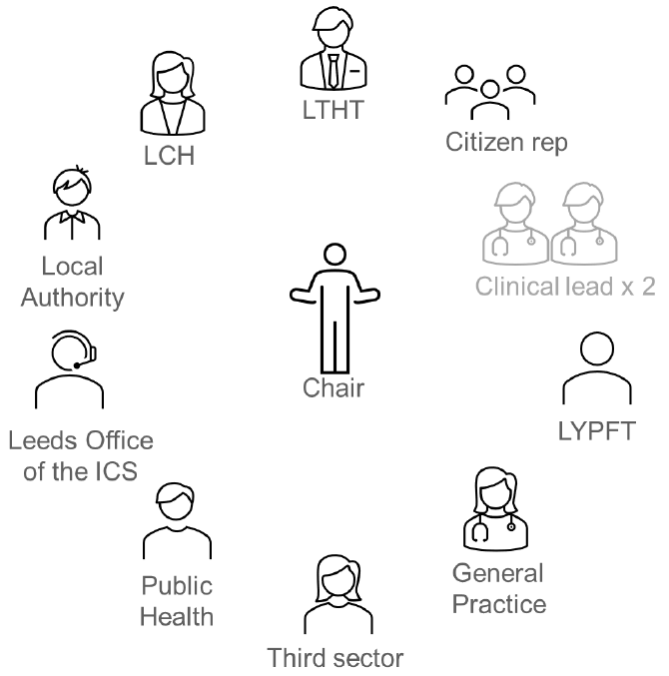
Population health (4)
Boards will be made up of senior people from across the health and care partnership.
The boards will
Represent everyone
Make important decisions
Not too big

Slide 12
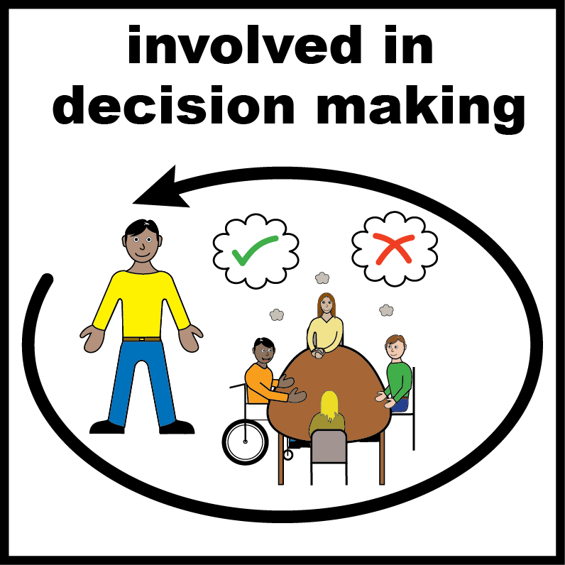
Population health (6)
What sort of decisions will the boards make?
Where to spend money
When to make changes to services
What is most important
How to get best value for money
It is important we involve people in decisions.
This workshop builds on our involvement so far and gives us an opportunity to plan future involvement together.

Slide 13
Experience of learning disability and neurodivergence care
In Leeds we want to plan, pay, and provide care that is:
Safe
Can keep going
Focussed on the patient
Value for money
We cannot do this without knowing what people with a learning disability or who are neurodivergent need.
We will 'start with what we already know' about people's experiences and only work with people when there are gaps in what we know.

Slide 14
Experience of learning disability and neurodivergence care (2)
Each board in Leeds is working with partners to look at what we already know.
The report will be used by the board to understand the needs of the learning disability and neurodivergent population and make decisions.
The insight report will:
Look at what we already know about people's needs, preferences and experiences
Show us the things people tell us about their care
Show us the gaps in our knowledge

Slide 15
Experience of learning disability and neurodivergence care (3)
People have told us that:
getting communication right is very important.
it is important to be correct in the case notes.
clear instructions and information about services would help.
they want to see services work together.
they want to be told what is happening any family / carers are included too.
services sometimes don’t make any changes to help get what they need.
Person centred care is important to people (including the choice of face-to-face appointments, longer appointments, and communicating in the right way for the person).

Slide 16
Experience of learning disability and neurodivergence care (4)
People have told us that:
the staff in health and care services are important.
staff have a big impact on their experience of services.
staff don't always understand learning disabilities and neurodivergence.
they have difficulties in getting to appointments.
more awareness of learning disabilities and neurodivergence is needed.
places like waiting rooms can be difficult and different waiting spaces can really help.

Slide 17
Experience of learning disability and neurodivergence care (5)
Things we haven't heard about:
Feedback from some services in Leeds.
People with neurodivergence that isn't autism (such as ADHD).
People from different ethnic communities
People from poorer areas.
People from LGBTQIA+ communities.
People who work
Carers
People who aren't online or don't use computers
Feedback from staff working in learning disability and neurodivergence services.

Slide 18
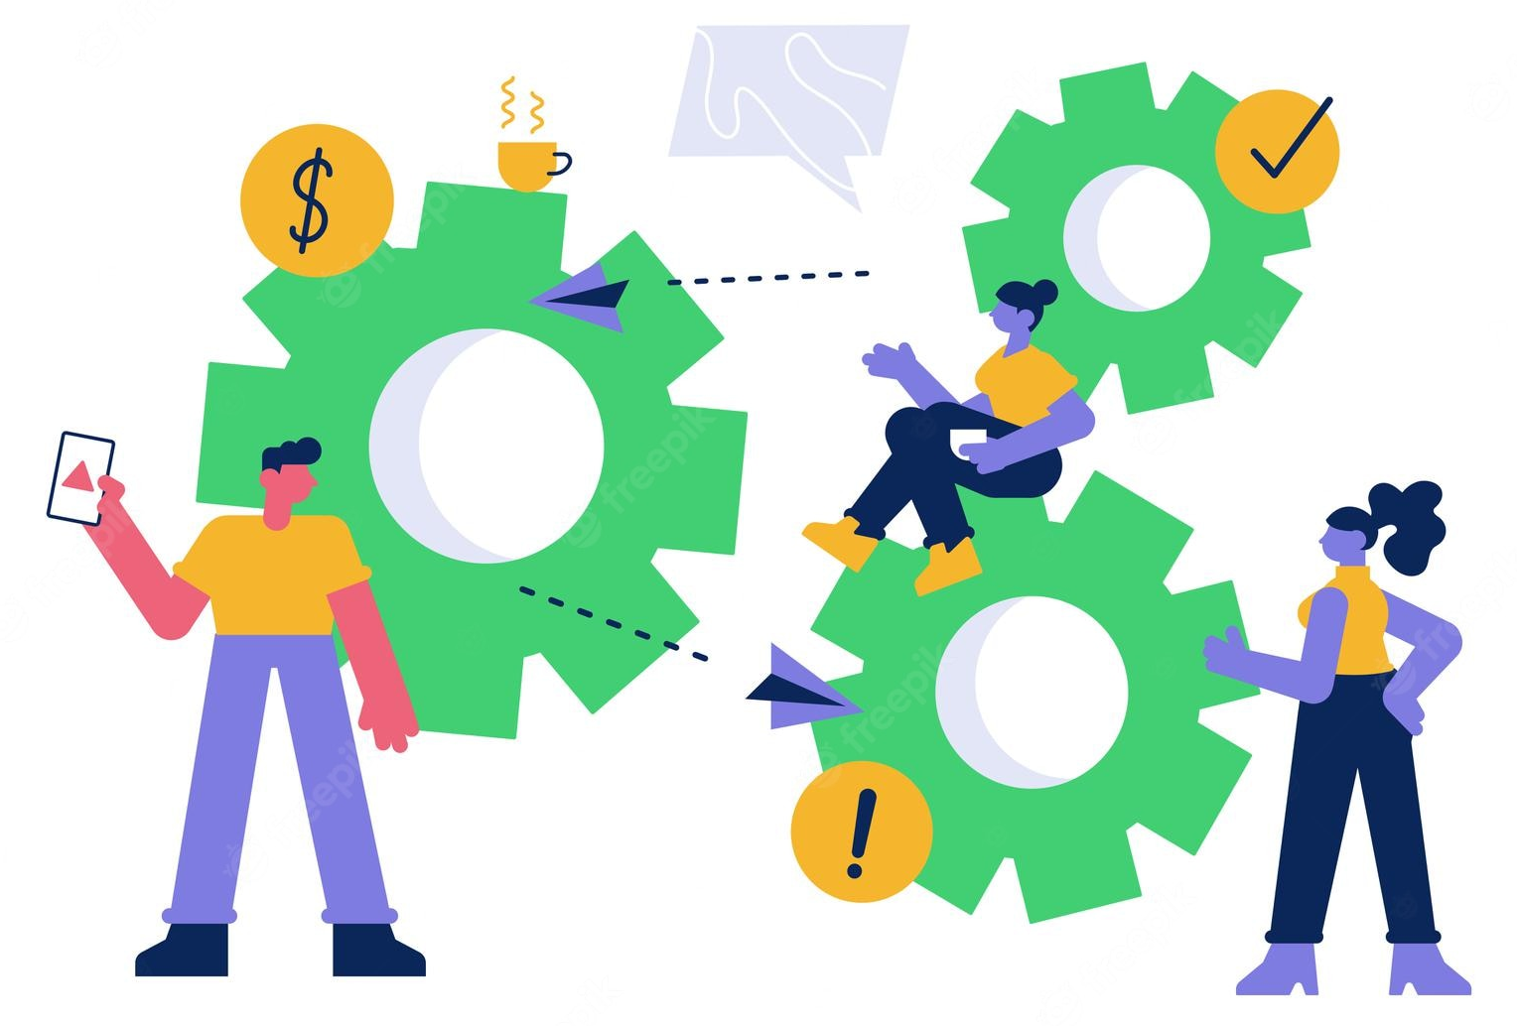
Experience of learning disability and neurodivergence care (7)
Groupwork
Do you agree with what we've talked about?
Is there anything we've missed?
What is the most important thing that we need to work on?

Slide 19
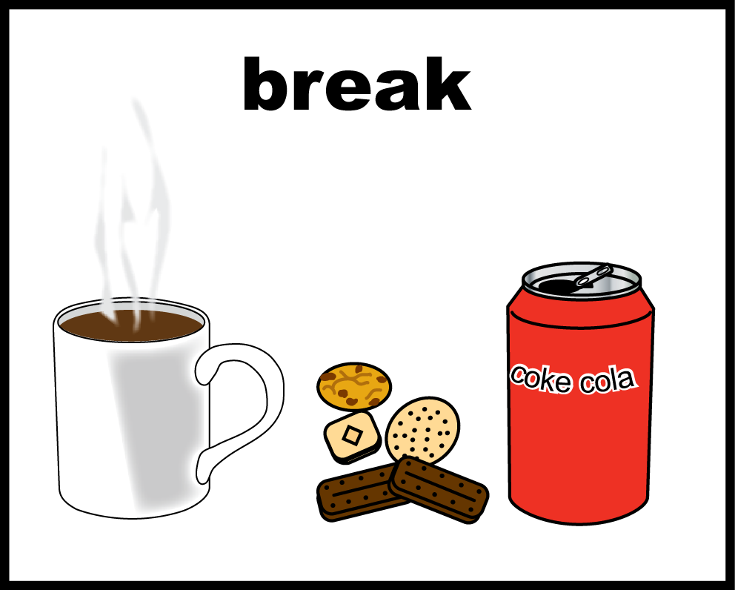
Break

Slide 20
Population goals
Over the last year we have worked together to agree a set of goals for learning disability and neurodiversity in Leeds.
These goals explain what we want to do to improve the lives of people with a learning disability, neurodivergent, or both, and their carers, family and friends.

Slide 21
Population goals (2)
Suggested goals for learning disability and neurodivergence care in Leeds
I live well, defined by what matters to me.
I receive high-quality, accessible, person-centred care and support.
I am included in all decisions about my life.
Each goal has a set of ways we see if we're doing the right thing.

Slide 22
Population goals (3)
Groupwork
Do you understand these goals?
Do the goals talk about what matters to you, your family, the people you represent?
What's the best way to tell you how we're doing?

Slide 23
Public involvement
We must involve people in the decisions we make.
We want you to know to that we are listening and involving to people in making our decisions
We call this 'public assurance'.

Slide 24
Public involvement (2)
Listened
We have listened and understood people's needs
Acted
We have used people's feedback to make decisions
Fed back
We have told people how we have used their feedback
Transparent & accountable

Slide 25
Public involvement (3)
There are lots of ways we involve people in our work:
Reports about what people have told us
Workshops like this one
We want to keep working together to:
Listen
Act
Feedback

Slide 26
Public involvement (4)
Groupwork
What do you think of the ways we are already involving people?
What does good public involvement look like?
How will you know that we are listening, acting and feeding back?

Slide 27
Next steps
Can you tell us what you thought about the session
We will use what you have told us to help us plan services
We will meet with other groups to talk about this work
We will use what you have told us to plan how we involve people

Slide 28
Thank you
Thank you

