Slide 1
Public Involvement Workshop
Mental health
February 2023

Slide 2

Recording
We are recording this session so that we can share the discussion with people who are unable to attend the meeting.
It will be available shortly on the Leeds Health and Care Partnership Website

Slide 3
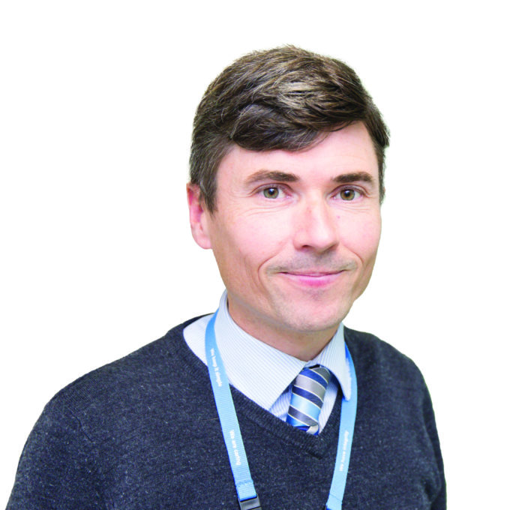
Welcome and Introductions
Chris Hosker
Medical Director and Psychiatrist, Leeds and York Partnership Foundation Trust (LYPFT) and Chair of the Mental Health Population board
Eddie Devine
Head of Pathway Integration for Mental Health and Learning Disability and Neurodiveristy

Slide 4
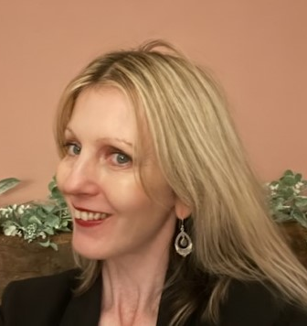
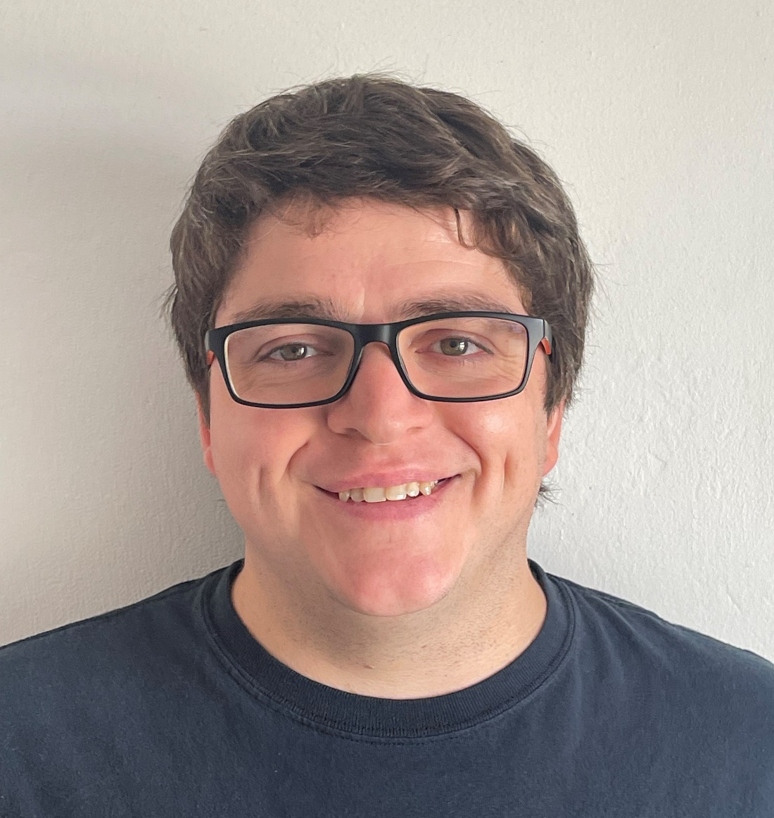
Welcome and Introductions (2)
Caroline Townsend
Pathway Integration Leader – Mental Health, NHS ICB in Leeds
Adam Stewart
Senior Insight, Involvement and Engagement Advisor, NHS ICB in Leeds

Slide 5
Aim and objectives
Aim
To develop our approach to public involvement in the population board
Objectives
Introduce population health and the board
Review and agree the findings of the insight report
Review and agree the draft outcomes for the board
Begin planning involvement on the gaps in our knowledge
Agree how we represent people at the board and provide public assurance

Slide 6
Outcomes of the workshop
By the end of the workshop participants should have had an opportunity to:
Understand the role of the board
Discuss the findings of the draft insight report
Influence the draft insight report
Discuss gaps in our knowledge
Suggest other gaps
Discuss the draft outcomes for mental health
Explore ways we can provide assurance that people's voices are heard at the board
Influence our approach to public representation and assurance on the board

Slide 7
Agenda
Population Health - What are population health boards and what is their role?
Experience of mental health care - What do we know about the experiences of people with mental health difficulties and their family? (our insight)
Population outcomes - How do we want things to be different for people with mental health difficulties and their families? (our outcomes)
Public representation and assurance – What does public representation look like on the board?
Next steps - What happens next?

Slide 8
Ground rules
Stick to the agenda
Be honest
Be open to new ideas
Listen to others
Respect confidentiality
Don’t judge
It's ok to ask for clarification and confirmation
Don't zoom and drive
Enjoy

Slide 9
Population health
Population health moves away from 'traditional' thinking about commissioning (planning and paying for) and providing services.
It thinks less about organisations and pathways and more about people, or 'populations'.
It focuses on:
The needs of people – what is important to people
Prevention – helping people stay well
Outcomes – the difference care makes
Reducing health inequalities
Working as partners rather than as organisations (system working)
The 'wider determinants of health' such as housing and transport
https://www.kingsfund.org.uk/publications/population-health-approach?gclid=EAIaIQobChMI8dWWp_ig-wIVCLbtCh2IKQ7REAAYASAAEgL2w_D_BwE

Slide 10
Population health (2)
How the Leeds population would look if we organised by need.

Slide 11
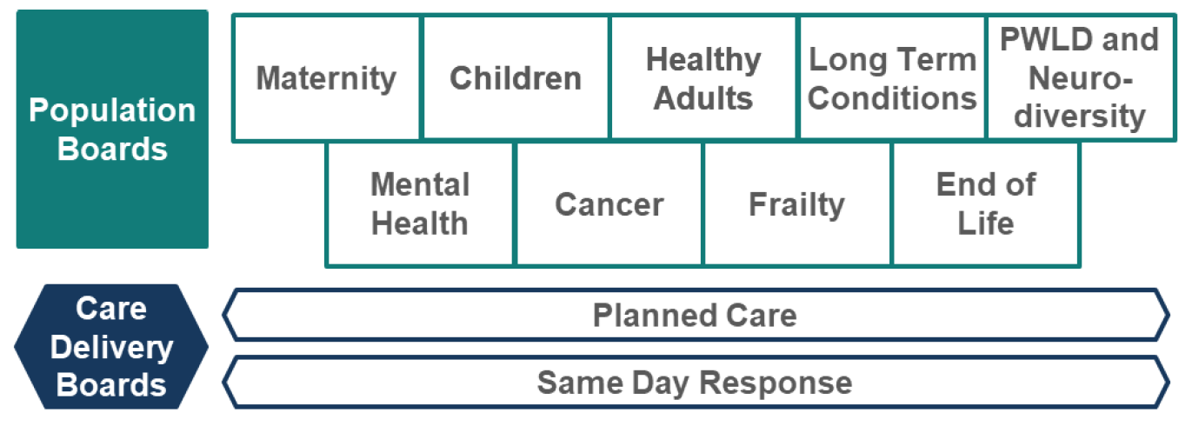
Population health (3)
How we will meet these needs in Leeds?
These boards are responsible for improving (or driving improvements in) the outcomes, experience and value of NHS spend for their respective population…
Working across organisations, across sectors, and focussed on people's needs.

Slide 12
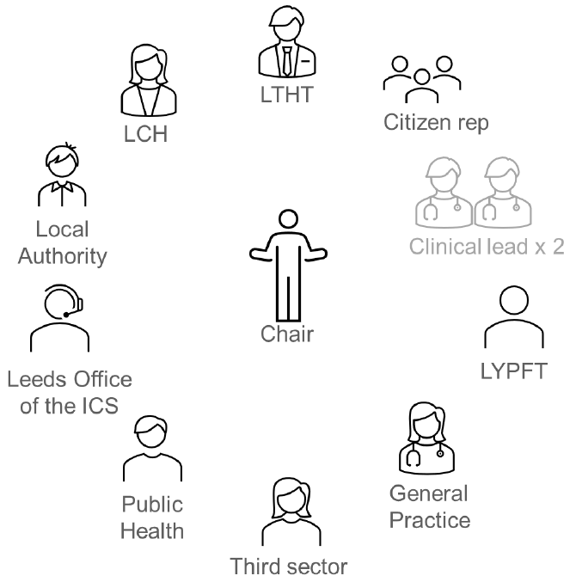
Population health (4)
Boards will be made up of senior representatives from across the health and care partnership.
The boards will be
Broad enough (to represent all partners)
Senior enough (to take critical decisions)
Small enough (to make these decisions)

Slide 13
Population health (5)
The Mental Health Population Board
Mental health care is defined as being:
“…just like physical health: everybody has it and we need to take care of it. Good mental health means being generally able to think, feel and react in the ways that you need and want to live your life. But if you go through a period of poor mental health, you might find the ways you’re frequently thinking, feeling or reacting become difficult, or even impossible, to cope with. This can feel just as bad as a physical illness, or even worse"
(Mind, 2022)
Depending on a person’s need; they will have access to a range of mental health care and support that includes:
Primary care mental health care (such as at your GP)
Community mental health care, delivered in the community by NHS and third sector (voluntary) services
Inpatient mental health care (a stay in hospital)
Self-care support and guidance (such as the Mindwell website)

Slide 14
Population health (6)
What sort of decisions will the boards make?
Where to allocate funding
When to make changes to services
What the priorities are
How to deliver value (value for money)
It is essential that we involve people in this decision-making process. This workshop builds on our involvement so far and gives us an opportunity to plan future involvement together.

Slide 15
Experience of mental health care
In Leeds we want to commission (plan and pay for) and provide care that is:
Safe
Sustainable
Patient-centred
Value for money
We cannot do this without understanding the needs, preferences and experiences of people in our population.
We are committed to 'starting with what we know' about people's experiences and engaging on the gaps in our knowledge.

Slide 16
Experience of mental health care (2)
Each population board in Leeds is working with partners to review what we already know (an insight review). Our findings will be written into an insight report which will be used by the board to understand the needs of the population and make decisions.
The insight report will:
Look at what we already know about people's needs, preferences and experiences
Identify the key themes (the things people often tell us about their care)
Highlight the gaps in our knowledge (the areas or communities we know least about)

Slide 17
Experience of mental health care (3)
Our insight review for mental health suggests the following themes:
People have told us that they want to see joint working from all mental health and care services
It is difficult to find information about local mental health and care services in Leeds, including from staff in services. This makes it difficult for people to access the right services at the right time.
People want communication to be clear, efficient and not make assumptions that people know how services work.
Person centred care is very important to people and there are a number of examples of how this should be achieved to ensure mental health and care meets the needs of each person and community
People have told us about the importance of the workforce in mental health and care services
People told us about a lack of understanding / awareness from staff across a range of services about their individual needs around mental health or other conditions, such as autism

Slide 18
Experience of mental health care (4)
Our insight review for mental health suggests the following themes:
People told us that waiting times to access crisis mental health care and waiting lists for therapy were too long.
People’s satisfaction with mental health and care services can influence whether they seek out help from services in the future.
People want involvement in service development and have told us what is important to them to achieve this.
Some people have told us about the difficulties they have in accessing mental health and care services due to the nature of their conditions, particularly if services are not local and people need to rely on transport and travel.
People from diverse communities have told us that we need to go to where they are to work with them on involvement in service development and involvement in care.
Service users and service providers told us that referral criteria can make it difficult for people to get support.
There are certain communities in Leeds that experience a higher rate of mental health difficulties than the general population, including people from LGBTQIA+ communities, including transgender people, and people from diverse ethnic communities.

Slide 19
Experience of mental health care (5)
Our insight review for mental health care suggests the following gaps:
Ethnically diverse communities (in particular people whose first language is not English
some areas of deprivation
People from LGBTQIA+ communities, including transgender people
Homeless people
Working age adults
Carers
People who are considered 'offline'
Feedback from people about how they manage and maintain their mental health
Feedback from staff working with people in mental health services

Slide 20
Experience of mental health care (6)
Additional gaps and considerations identified by stakeholders
In relation to service user engagement, there needs to be a West Yorkshire ICB system-wide approach rather than local place (just Leeds or Bradford) approach - as there is a danger that survivors are burnt out by local demands for involvement, or in many cases some place areas are unable to access such populations. To avoid that there should be a central ICB advisory panel in relation to sexual violence trauma - which brings together the insight and lived experience of sexual crime survivors - where it can be pulled together with all the reports and research to support better service options and the commissioning to drive and sustain them etc. Importantly it would also safeguard survivors by ensuring best practice engagement / support (West Yorkshire Survivors).
Training for Gypsy and Traveller community members is being developed called ‘Keeping our Friends and Family Safe’, focused on having conversations with loved ones who may be at risk and feeling overwhelmed emotionally. Still a big taboo in the community (Leeds GATE).
There is a huge amount of carer breakdown. They are incredibly isolated looking after someone with dementia, it is a full-time job and exhausting (Alzheimer’s Society).
The ‘Dementia Voice’ groups we run elsewhere in West Yorkshire aren’t in Leeds (Alzheimer’s Society).

Slide 21

Experience of mental health care (7)
Groupwork
Do you agree with the themes and gaps?
Have we missed any themes or gaps in our insight?
How do we prioritise and plan involvement work on the gaps?

Slide 22
Population outcomes
Over the last year we have been working with our partners to agree a set of outcomes for mental health in Leeds. These outcomes explain what we want to achieve to improve the lives of people with mental health difficulties and their carers, family and friends.
The outcomes have been developed with service providers and voluntary sector organisations that represent people using mental health services. The outcomes were shaped used patient, carer, family and staff feedback from various surveys and involvement activities.

Slide 23
Population outcomes (2)
Outcomes for mental health care in Leeds (same as the Leeds Mental Health Strategy)
People of all ages and communities are comfortable in talking about their mental health and wellbeing.
People are part of mentally healthy, safe, and supportive families, workplaces, and communities.
People’s quality of life will be improved by timely access to appropriate mental health information, support, and services.
People are actively involved in their mental health and their care.
People with long-term mental health conditions live longer and lead fulfilling healthy lives.

Slide 24
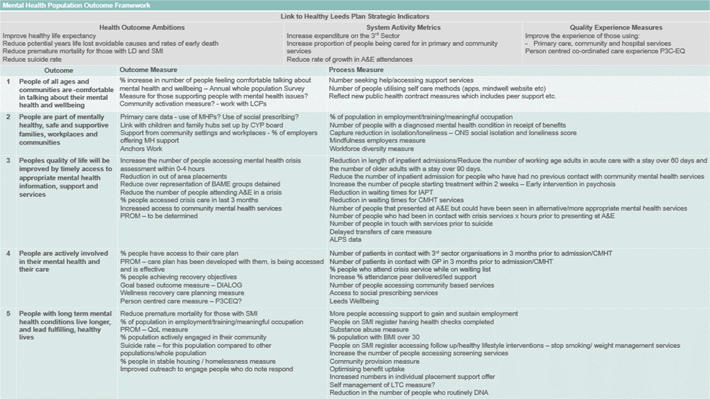
Population outcomes (3)
Each outcome has a set of 'measurables'. These are things we will use to measure whether we have achieved our outcomes.

Slide 25
Population outcomes (4)
Groupwork
Do you understand these outcomes?
Do the outcomes reflect what matters to you / your family / the people you represent?
How do you think we can best demonstrate improvements against these outcomes?

Slide 26
Public representation and assurance
We have a legal and a moral duty to involve people in the decisions we make.
We want patients, carers and the public to be assured that we are putting people at the heart of our decision-making. We call this approach 'public assurance'.

Slide 27
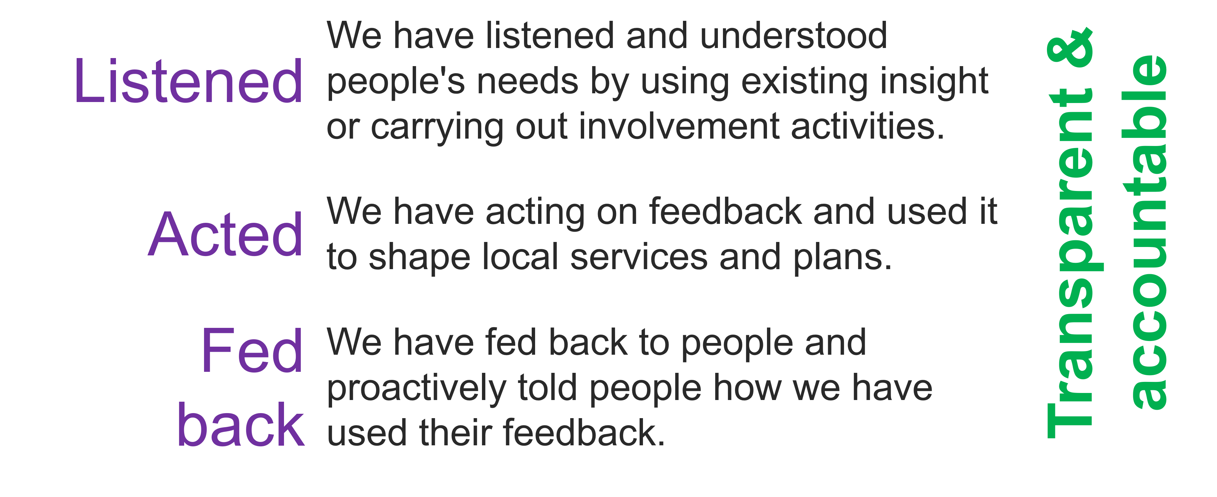
Public representation and assurance (2)
For the public to feel assured we need to demonstrate we have:

Slide 28
Public representation and assurance (3)
There are lots of ways we provide assurance that we have involved people in our work:
Insight reviews
Insight reports
Workshops
We want to continue and build on our public assurance work. This will involve working with our partners and local people to create new ways to represent the views of patients, their families and staff on our boards.

Slide 29
Public representation and assurance (4)
Groupwork
What do you think of the ways we are already involving people (insight reviews / workshops)?
What does public representation look like for you?
What would make you feel confident that we are listening, acting and feeding back?

Slide 30
Next steps
Evaluation of the session
Update insight report based on todays feedback
Use feedback to develop an approach to representation
Begin planning involvement on the gaps in our knowledge

Slide 31
Thank you

