Slide 1
Public Involvement Workshop
Long Term Conditions (LTC)
Wednesday 1 Feb 2023, 9am – 11am

Slide 2

Recording
We are going to record this session so that we can share our discussion with people who are unable to attend the workshop.
Please feel free to turn your camera off if you do not wish to be shown on the recording.
The recording will be available shortly on the Leeds Health and Care Partnership Website.

Slide 3
Welcome and Introductions
David Wardman
Pharmacist and Chair of the Long Term Conditions
Population Board
Lindsay McFarlane
Head of Pathway Integration (Long Term Conditions) NHS West Yorkshire Integrated Care Board (ICB) in Leeds
Adam Stewart and Huma Malik
Insights, Communications and Involvement Team
NHS West Yorkshire ICB in Leeds

Slide 4
Aim and objectives
Aim
To help develop our approach to public involvement in the work of the long term conditions population board
Objectives
Introduce the population health approach and the LTC board
Review the findings of the insight report
Review the draft outcomes for the board
Consider gaps in our findings and anything else we may have missed
Consider how people's voice is represented at the board and how we provide public assurance

Slide 5
Outcomes of the workshop
By the end of the workshop participants should have had an opportunity to:
Understand the role of the long term conditions population board
Discuss the findings of the draft insight report
Influence the draft insight report
Discuss gaps in our findings
Suggest other areas of focus
Discuss the draft outcomes for the long term conditions population board
Explore ways we can provide assurance that people's voices are heard at the board
Influence our approach to public representation and assurance on the board

Slide 6
Agenda
Population health - What are population boards and what is their role?
Experience of LTCs - What do we already know about the experiences of people living with long term conditions and their families and carers? (insight)
Population outcomes - How do we want things to be different for people living with LTCs and their families and carers? (outcomes)
Public representation and assurance – What does public representation look like on the board and how can we be assured that it's working?
Next steps - What happens next?

Slide 7
Ground rules
Stick to the agenda
Stay on mute unless you're speaking
Make space for everyone to speak
Have your say – use the hand signal or chat box to ask questions or share comments
Respect confidentiality
Enjoy the session!

Slide 8
Population health
As an approach, population health moves away from 'traditional' thinking about commissioning (planning and paying for) and providing health and care services.
It focuses less on organisations and pathways and more on the needs of the people, or populations, who use them.
It looks at:
The needs of people – what matters most to populations of people
Prevention – helping people stay healthy and well
Outcomes – the positive differences health care services and support can make
Reducing health inequalities
Working together in partnership rather than as individual organisations (system working)
The 'wider determinants of health' such as housing and transport
https://www.kingsfund.org.uk/publications/population-health-approach?gclid=EAIaIQobChMI8dWWp_ig-wIVCLbtCh2IKQ7REAAYASAAEgL2w_D_BwE

Slide 9
Population health
How the Leeds population would look if we organised by need.

Slide 10
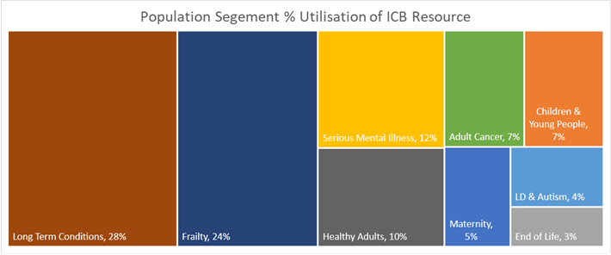
Population health
How the Leeds population would look if we divided it across our nine population boards, showing the level of need and percentage of resource for each.

Slide 11
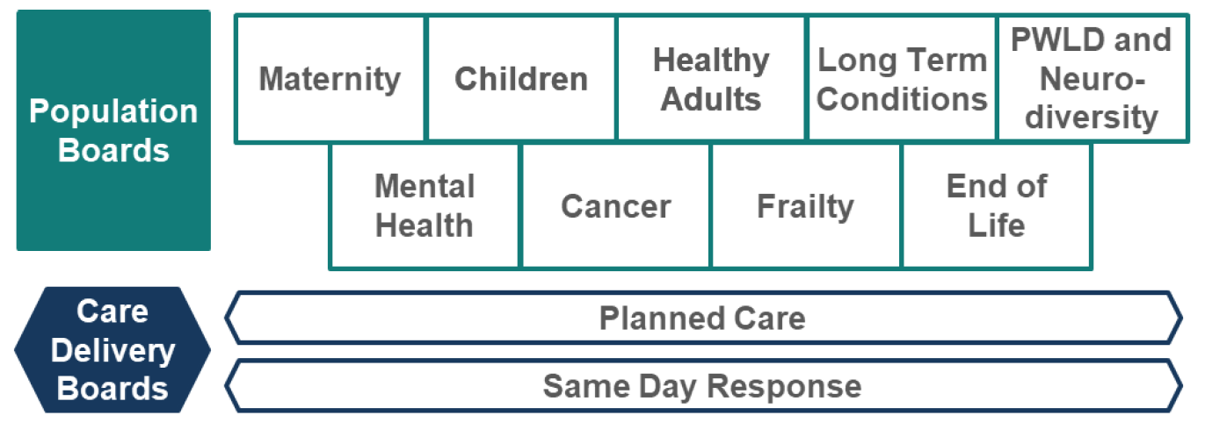
Population health
We aim to address these needs through a framework of nine population and two care delivery boards:
These boards are responsible for improving (or driving improvements in) the outcomes, experience, and the value of the NHS spend, for their respective population. They work across organisations and sectors with a clear focus on their population's particular needs.

Slide 12
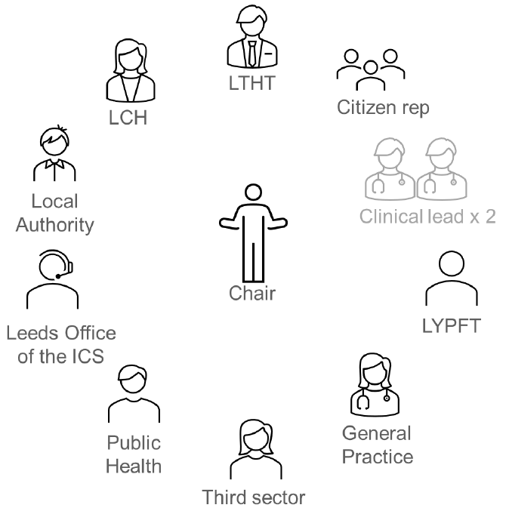
Population health
Boards are made up of senior representatives from across the health and care partnership including representatives from the third sector and from Healthwatch Leeds.
There is also space for 'citizen' or people's voice representation, which we are thinking about today.
The boards are:
Broad enough (to represent all partners)
Senior enough (to take critical decisions)
Small enough (to make these decisions)

Slide 13
Population health
The LTC Population Board
Long-term conditions (LTCs), or chronic diseases, are conditions for which there is currently no cure, and which are managed with drugs and other treatment, for example: diabetes, asthma, arthritis and hypertension. It has been estimated that treatment and care for people with LTCs takes up around £7 in every £10 spent in health and social care.
You are more likely to get a LTC as you get older but as LTCs affect all ages most people living with a LTC are under 65. There is also a strong link with deprivation with many LTCs being more common and more severe in deprived areas and appearing earlier in life.
LTCs can have a huge impact on people's lives and mental wellbeing. More and more people are living with more than one LTC (multimorbidity), expected to be two-thirds of adults over 65 by 2035.
The Leeds LTC population board brings together partners from across the city to improve care, design more joined-up and sustainable LTC services and support, and make better use of public resources.
Webpage: https://www.healthandcareleeds.org/have-your-say/shape-the-future/populations/long-term-conditions/

Slide 14
Population health
What sort of decisions are the boards making?
Where to allocate funding
When to make changes to services
What the priorities are and how best to achieve the outcomes
What can be done to address health inequalities
How best to work with other boards and wider partners to avoid silo-working
How best to deliver value (value for money)
It is essential that local people's views are included in these decision-making processes.
This workshop builds on what we have learned so far about people's experiences of living with LTCs in Leeds, and gives us an opportunity to begin to think about what how we can involve people more moving forward.

Slide 15
Experience of LTCs
The board is working with partners to establish what we already know (by carrying out an insight review) about the experiences of local people living with LTCs, their families and their carers.
Our findings to date have been collected into an insight report which will be used by the board as a developing evidence base, to learn more about the needs of this population and to make more informed decisions as a result.
The insight report:
Outlines what we already know about people's needs, preferences and experiences of living with LTCs in Leeds
Identifies key themes (the things people often tell us about their care)
Highlights gaps in our knowledge (e.g. the areas or communities whose experiences we know least about)

Slide 16
Experience of LTCs
Our insight review for LTCs suggests the following themes:
Information – the need for accessible and timely information, which can be tailored to particular communities who may be at a higher risk of certain conditions – more targeted approaches.
Communications – ideally with a named worker or single point of contact. People appreciate regular contact, for example, annual check-ups or check-ins. In some agreed cases, communications should also always include family members or carers.
Health inequality – there are clear links relating to a higher prevalence of long-term conditions in areas of higher deprivation across the city.
Health inequality – expectations in relation to self-management need to take into account communities who speak different languages, have additional needs or who may find written materials difficult to understand.

Slide 17
Experience of LTCs
Our insight review for long term conditions suggest the following gaps:
Feedback from staff working with people living with long term conditions and their families and carers
Additional gaps and considerations will continue to be identified and updated by ongoing conversations, like the one we're having today.

Slide 18

Experience of LTCs
Discussion
Do you agree with the main themes we have found so far?
What about gaps… where else should we be looking, or who should we be talking to?
What matters most to people living with LTCs, their families and carers?

Slide 19
Population outcomes
Over the last year we have been working with our partners to agree a set of outcomes for our long term conditions work in Leeds. These outcomes explain what we as a board, and as a health and care partnership, want to achieve to improve the experiences of people living with long term conditions and their carers, families and friends.
The outcomes have been developed with healthcare service providers and voluntary sector organisations that work alongside people using services and support for long term conditions. The outcomes were shaped using patient, carer, family and staff feedback from various surveys and involvement activities.
Each one has a set of measures which will help us to see if we are on track to achieving our outcomes.

Slide 20
Long Term Conditions Outcomes
I’m as healthy and as well as I can be with my Long Term Condition(s)
Example measure: Better patient reported outcome scores
People with a LTC return to and maintain their normal activities and lifestyle in ways that matter to them
Example measure: More people are able to be active in their communities
People with a LTC take an active role in managing their condition
Example measure: More collaborative and holistic anticipatory care and support plans for every person

Slide 21
Population outcomes
Discussion
Do these outcomes make sense to you?
Do they reflect what matters to you/your family/the people you represent?
How would you like us to demonstrate improvements against these outcomes?

Slide 22
Public representation and assurance
As an organisation, we have a legal and a moral duty to involve people in the plans and decisions we make about the provision of healthcare in Leeds.
It's important that patients, carers and the wider public are aware, and assured, that we are working to ensure that people's voices and experiences are at the heart of our decision-making. It really matters that people feel that their voices and experiences are being properly represented, and that they're making a difference.
We call this providing 'public assurance'.

Slide 23
Public representation and assurance
For members of the public to feel assured we need to demonstrate we have:
Listened | We have listened to people by using existing insight or carrying out involvement activities | Transparent & accountable
Acted | We have acted on feedback and are using it to shape local services and plans.
Fed back | We have fed back to people and have let them know how we have used their feedback

Slide 24
Public representation and assurance
There are various ways people's voice and experience can be taken into account by the board:
By an individual representative
By a sub-group which runs parallel to the board
By links with a particular group or organisation
By increasing feedback to services directly
Our work to strengthen public assurance is ongoing – today we are keen to hear your thoughts on how the voices and experiences of people living with LTCs and their families and carers would be best represented at the board.

Slide 25
Public representation and assurance
Discussion
What do you think of the ways we are involving people (insight reviews / workshops)?
What would good public representation look like for you?
What would make you feel confident or assured that we are listening, acting and feeding back?

Slide 26
Next steps - We will…
Add a copy of this recording to the long term conditions webpage:
Long-Term Conditions - Leeds Health and Care Partnership (healthandcareleeds.org)
Share the slides and an evaluation survey of the session
Use today's feedback to help develop our approach to representation
Begin looking at the gaps in our knowledge and think about involving people to help us learn more. Please send any additional insight or comments to caroline.mackay2@nhs.net
Organise a follow-up meeting to discuss this further
But for now… Thank you for joining our session – your input is very much appreciated!

Slide 27
Thank you!

