Slide 1
Public Involvement Workshop
Maternity
January 2023

Slide 2
Recording
We are recording this session so that we can share the discussion with people who are unable to attend the meeting.
It will be available shortly on the Leeds Health and Care Partnership Website

Slide 3
Aim and objectives
Aim
To develop our approach to public involvement in the population board
Objectives
Introduce population health and the board
Review and agree the findings of the insight report
Review and agree the draft outcomes for the board
Begin planning involvement on the gaps in our knowledge
Agree how we represent people at the board and provide public assurance

Slide 4
Outcomes of the workshop
By the end of the workshop participants should have had an opportunity to:
Understand the role of the board
Discuss the findings of the draft insight report
Influence the draft insight report
Discuss gaps in our knowledge
Suggest other gaps
Discuss the draft outcomes for Maternity
Explore ways we can provide assurance that people's voices are heard at the board
Influence our approach to public representation and assurance on the board

Slide 5
Agenda
Population Health - What are population health boards and what is their role?
Experience of maternity care - What do we know about the experiences of people using maternity services and their family? (our insight)
Population outcomes - How do we want things to be different for people using maternity services and their families? (our outcomes)
Public representation and assurance – What does public representation look like on the board?
Next steps - What happens next?

Slide 6
Ground rules
Stick to the agenda
Be honest
Be open to new ideas
Listen to others
Respect confidentiality
Don’t judge
Enjoy

Slide 7
Population Health
Population Health moves away from "traditional" thinking about commissioning (planning and paying for) and providing services.
It thinks less about organisations and pathways and more about people or "populations".
It takes an approach to optimise a population's health over people's lifetimes.
It focuses on:
The needs of people – what is important to people
Prevention – helping people stay well
Outcomes – the difference care makes
Reducing health inequity – addressing avoidable differences in health outcomes based on certain demographics due to systemic barriers which are not the fault of those experiencing the inequity.
Working as partners rather than as organisations (system working)
The "wider determinants of health" such as housing and transport

Slide 8
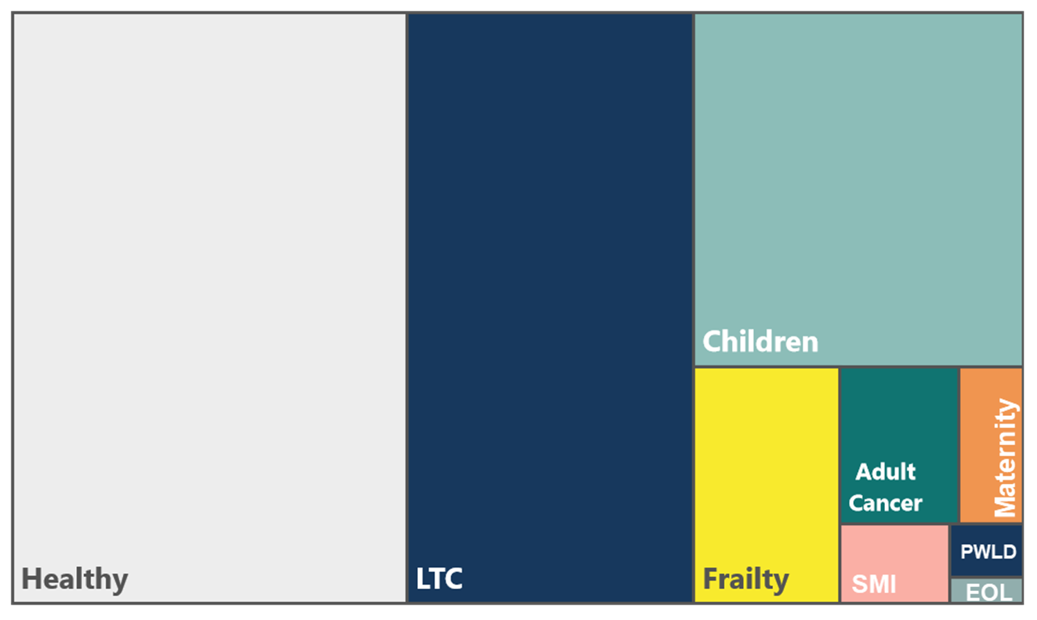
What would Leeds' population look like if you organised it by need?

Slide 9
Why organise by people's needs?
Different people in Leeds have different needs
Some people's needs are similar
Grouping people into segments of similar needs allows us to look at how we use our staff, money and time to best meet these needs
Organisations still critical and fundamental to how we run effectively
… but we should also be looking at how we are achieving the outcomes we want across organisations.

Slide 10
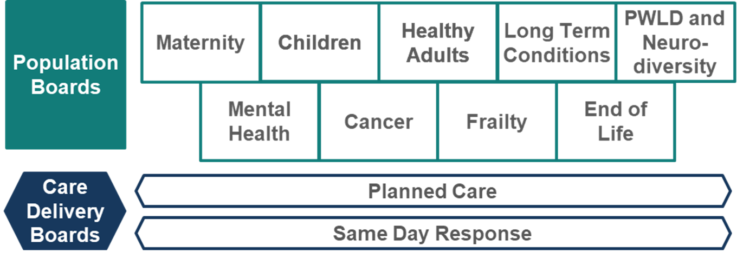
Population and Care Delivery Boards
Responsible for improving (or driving improvements in) the outcomes, experience and value of NHS spend for their respective population… Working across organisations, across sectors, and focussed on people's needs.

Slide 11
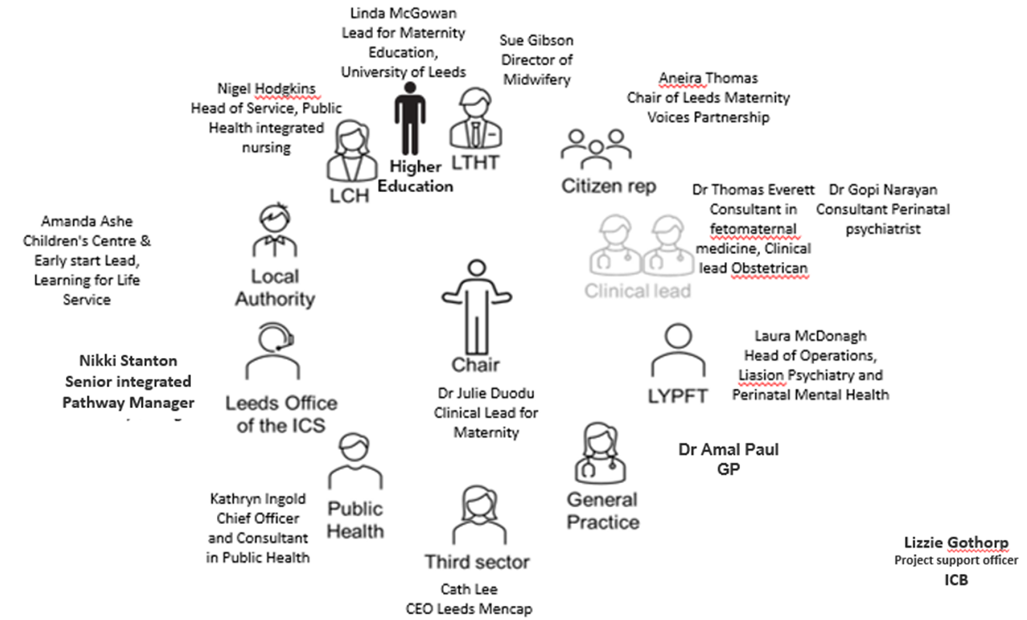
'Who' is a board - who will be making decisions about how we care for populations in Leeds?
Broad enough (to represent all partners)
Senior enough (to take critical decisions)
Small enough (to make these decisions)

Slide 12
What sort of decisions might boards make?
Where to allocate funding?
When to make changes to services.
What the priorities are
How to deliver value (value for money, the Leeds £)
It is essential that we involve people in this decision-making process. The citizen voice through MVP chair is one way but this workshop builds on our involvement so far and gives us an opportunity to plan future involvement together.

Slide 13
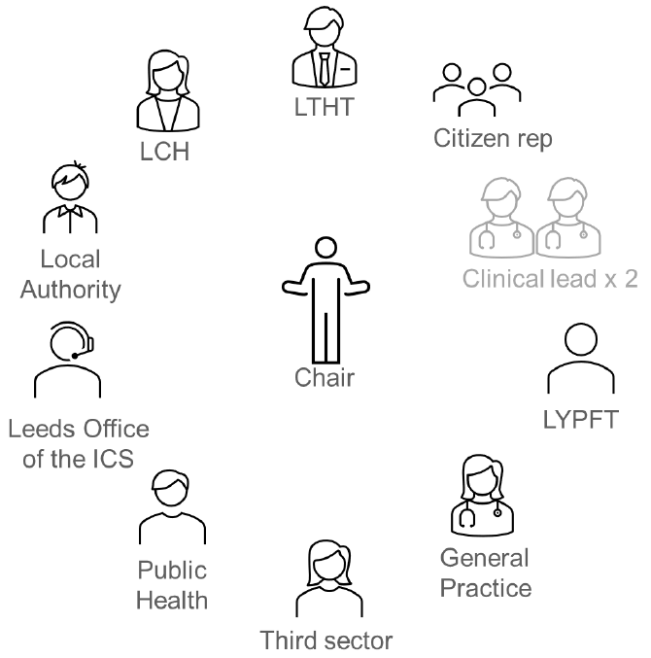
Population health
The Maternity Population Board
Maternity care is defined as:
Maternity care refers to the health services provided to pregnant women and pregnant people, babies, and families throughout the whole pregnancy, during labour and birth, and after birth for up to six weeks. It can include monitoring the health and well-being of the mother/birthing parent and baby, health education, and assistance during labour and birth.

Slide 14
Experience of maternity care
In Leeds we want to commission (plan and pay for) and provide care that is:
Safe
Sustainable
Patient-centred
Value for money
We cannot do this without understanding the needs, preferences and experiences of people in our population.
We are committed to 'starting with what we know' about people's experiences and engaging on the gaps in our knowledge.

Slide 15
Experience of maternity care
Each population board in Leeds is working with partners to review what we already know (an insight review). Our findings will be written into an insight report which will be used by the board to understand the needs of the population and make decisions.
The insight report will:
Look at what we already know about people's needs, preferences and experiences
Identify the key themes (the things people often tell us about their care)
Highlight the gaps in our knowledge (the areas or communities we know least about)

Slide 16
Experience of maternity care
Our insight review for maternity suggest the following themes:
•
Personalised Care
• Continuity of care is key (not repeating same story and easing stress and anxiety) & having the same midwife or team from the start
• Positive environments are important (home from home feel)
Perinatal Mental Health
• Peer support can be invaluable as well as better signposting to peer support
•More personalised care can make a positive impact (especially for mums with learning difficulties)
• Taboo/stigma felt, especially in the Bangladeshi community
• Think “family” around mental health, so partners and dads are not forgotten about

Slide 17
Experience of maternity care (cont)
•
Reducing Health Inequalities
• Utilise peer support more within diverse communities
• Poor communication/understanding negatively affect people with learning disabilities
• Better cultural awareness needed by staff, and tailored breastfeeding support.
•Those in Leeds who had Haamla midwives said they always used telephone interpreters and they felt respected and cared for by their midwives. Those who had non specialist midwives said their midwife didn’t always use an interpreter
Preparation for Parenthood
• Teaching parenting skills in different settings, e.g., in schools, would help to prepare parents-to-be
• Involve dads/partners more, and ask what they need
• Young mums do not like jargon
• Breastfeeding support targeted at different groups; peer support very important

Slide 18
Experience of maternity care
Our insight review for maternity care suggest the following gaps:
Whilst acknowledging that it is impossible to seek the views of everyone, the areas that stand out as being a current gap are the LGBTQ plus, Gypsy and Traveller community, and women with physical disabilities and sensory impairments.
Additional gaps and considerations identified by stakeholders
To be discussed

Slide 19
Experience of maternity care
Groupwork
Do you agree with the themes and gaps?
Have we missed any themes or gaps in our insight?
How do we prioritise and plan involvement work on the gaps?

Slide 20
Population outcomes
Over the last year we have been working with our partners to agree a set of outcomes for maternity care in Leeds. These outcomes explain what we want to achieve to improve maternity care in Leeds providing equitable care for all and focussing on reducing health inequalities.
The outcomes have been developed with service providers and voluntary sector organisations that represent people using maternity services.

Slide 21
Population outcomes
Draft outcomes for maternity care in Leeds
People receive personalised care maternity care safely
Families and babies are emotionally healthy
Families and babies are physically healthy
People feel prepared for parenthood

Slide 22
Population outcomes
Groupwork
Do you understand these outcomes?
Do the outcomes reflect what matters to you/your family/the people you represent?
How would you like us to demonstrate improvements against these outcomes?

Slide 23
Public representation and assurance
We have a legal and a moral duty to involve people in the decisions we make.
We want patients, carers and the public to be assured that we are putting people at the heart of our decision-making. We call this approach 'public assurance'.

Slide 24
Public representation and assurance
For the public to feel assured we need to demonstrate we have:
Listened | We have listened to people by using existing insight or carrying out involvement activities | Transparent & accountable
Acted | We have acting on feedback and used it to shape local services and plans.
Fed back | We have fed back to people and proactively telling people how we have used their feedback

Slide 25
Public representation and assurance
There are lots of ways we provide assurance that we have involved people in our work:
Insight reviews
Insight reports
Workshops
We want to continue and build on our public assurance work. This will involve working with our partners and local people to create new ways to represent the views of patients, their families and staff on our boards.

Slide 26
Public representation and assurance
Groupwork
What do you think of the ways we are already involving people (insight reviews/workshops)?
What does public representation look like for you?
What would make you feel confident that we are listening, acting and feeding back?

Slide 27
Next steps
Evaluation of the session
Update insight report based on todays feedback
Use feedback to develop an approach to representation
Begin planning involvement on the gaps in our knowledge

Slide 28
Thank you

