Slide 1
Public Involvement Workshop
Primary Care V1.1
Feb 2023

Slide 2

Recording
We are recording this session so that we can share the discussion with people who are unable to attend the meeting.
It will be available shortly on the Leeds Health and Care Partnership Website

Slide 3
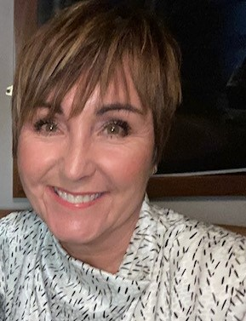
Welcome and Introductions
Gaynor Connor
Director of Primary Care and Same Day Response and chair of the Primary Care Board

Slide 4
Aim and objectives
Aim
To develop our approach to public involvement in the board
Objectives
Introduce population health and the board
Review and agree the findings of the insight report
Review the aims of the board
Begin planning involvement on the gaps in our knowledge
Agree how we represent people at the board and provide public assurance

Slide 5
Outcomes of the workshop
By the end of the workshop participants should have had an opportunity to:
Understand the role of the board
Discuss the findings of the draft insight report
Influence the draft insight report
Discuss gaps in our knowledge
Suggest other gaps
Discuss our aims for primary care in Leeds
Explore ways we can provide assurance that people's voices are heard at the board
Influence our approach to public representation and assurance on the board

Slide 6
Agenda
Population Health - What are population health boards and how do they link to the Primary Care Board
Experience of primary care - What do we know about the experiences of people using primary care and their family? (our insight)
Aims of the board - How do we want things to be different for using primary care and their families?
Public representation and assurance – What does public representation look like on the board?
Next steps - What happens next?

Slide 7
Ground rules
Don't zoom and drive!
Stick to the agenda
Be honest
Be open to new ideas
Listen to others
Respect confidentiality
Don’t judge
Enjoy

Slide 8
Population health
Population health moves away from 'traditional' thinking about commissioning (planning and paying for) and providing services.
It thinks less about organisations and pathways and more about people, or 'populations'.
It focuses on:
The needs of people – what is important to people
Prevention – helping people stay well
Outcomes – the difference care makes
Reducing health inequalities
Working as partners rather than as organisations (system working)
The 'wider determinants of health' such as housing and transport
https://www.kingsfund.org.uk/publications/population-health-approach?gclid=EAIaIQobChMI8dWWp_ig-wIVCLbtCh2IKQ7REAAYASAAEgL2w_D_BwE

Slide 9
Population health (2)
How the Leeds population would look if we organised by need.

Slide 10
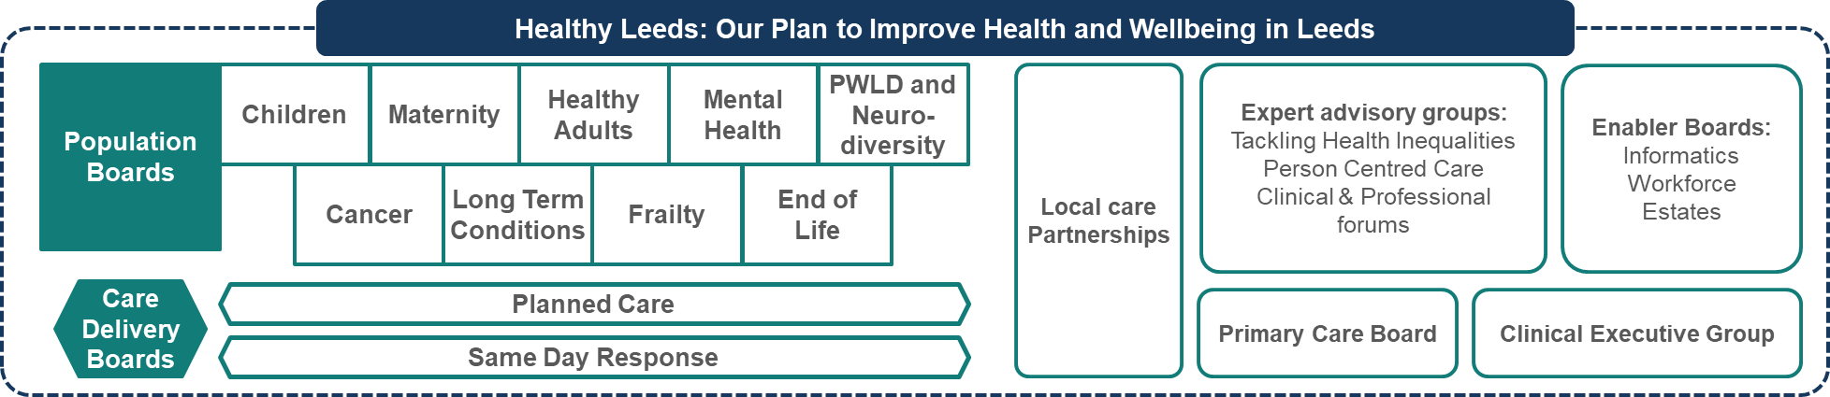
Population health (3)
How we will meet these needs in Leeds?

Slide 11
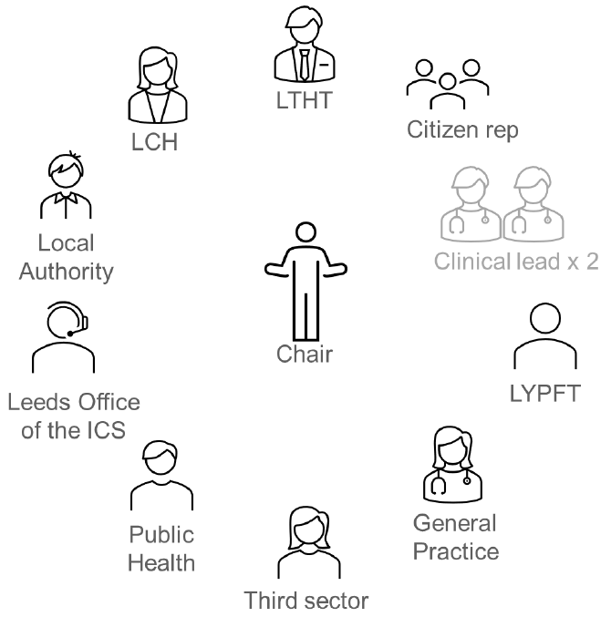
Population health (4)
Boards will be made up of senior representatives from across the health and care partnership.
The boards will be
Broad enough (to represent all partners)
Senior enough (to take critical decisions)
Small enough (to make these decisions)

Slide 12
Population health (5)
The Primary Care Board
Primary care services provide the first point of contact in the healthcare system, acting as the ‘front door’ of the NHS. Primary care includes general practice, community pharmacy, dental, and optometry (eye health) services.
Your local GP practice provides a wide range of health services, including medical advice, vaccinations, examinations and treatment, prescriptions for medicines, referrals to other health services and social services. In Leeds, there are 92 GP practices, which care for around 900,000 people. Every practice in Leeds is a member of a primary care network (PCN). This is a group of practices which works together and with community, mental health, social care, pharmacy, hospital and voluntary organisations in their local areas.
Community pharmacists are highly trained healthcare professionals who play a key role in providing quality healthcare to patients. As well as ensuring the safe supply and use of medicines, pharmacists can advise on common problems such as coughs, colds, aches and pains, as well as healthy eating and stopping smoking. They can also help you decide whether you need to see a doctor.
Dentists work to prevent and treat dental and oral disease, correct dental irregularities (particularly in children) and treat dental and facial injuries.
Opticians provide eye health services for patients.

Slide 13
Population health (6)
The Primary Care Board - functions
NHS England has formally delegated specific duties relating to Primary Medical Services i.e. those services that are delivered through the national GP contract.
Areas that the Board will be responsible for include:
Permanent practice closures
Procurements
Practice Mergers
Local incentive schemes
Contract Assurance and associated actions
List closure applications
Practice Boundary Changes
Contract variations
In some cases, the final decision will rest with the Leeds Committee of the Integrated Care Board particularly practice closures or mergers.

Slide 14
Population health (7)
The Primary Care Board – programme areas
The Primary Care Board has oversight and assurance of a number of key programme areas which includes:
Primary Care Access
Provider Relationships (the contracts we hold)
Primary Care Network Development
Increasing and developing the Workforce
Estates and Digital
Improving Outcomes
Improving Quality and Patient Experience

Slide 15
Population health (8)
The Primary Care Board – involvement and experience
Engagement with patients regarding primary care can happen at a number of levels such as:
Routine / ongoing engagement through practices Patient Participation Groups
due to a specific issues affecting an individual practice or Primary Care Network
changes to a service affecting the whole City
We monitor patient experience through the annual patient survey and through other feedback mechanisms such as complaints, friends and family test, care opinion and nhs.uk
After a very short wait on the phone at 8am I was given the option of either a face to face or telephone appointment. The admin staff were friendly and helpful. My telephone appointment went smoothly and I received appropriate treatment from the doctor who was professional and obviously cared
The telephone line is always engaged, no on line appointments available. I do not know what the answer to the problem is, but surely, if a system is not working you need to look for a solution to provide a better one. I don't like to complain as I appreciate that you do a wonderful job overall and been tested to your maximum over the past few years.

Slide 16
Population health (9)
It is essential that we involve people in this decision-making process. This workshop builds on our involvement so far and gives us an opportunity to plan future involvement together.

Slide 17
Experience of primary care
In Leeds we want to commission (plan and pay for) and provide care that is:
Safe
Sustainable
Patient-centred
Value for money
We cannot do this without understanding the needs, preferences and experiences of people in our population.
We are committed to 'starting with what we know' about people's experiences and engaging on the gaps in our knowledge.

Slide 18
Experience of primary care (2)
Each board in Leeds is working with partners to review what we already know (an insight review). Our findings will be written into an insight report which will be used by the board to understand the needs of the population and make decisions.
The insight report will:
Look at what we already know about people's needs, preferences and experiences
Identify the key themes (the things people often tell us about their care)
Highlight the gaps in our knowledge (the areas or communities we know least about)

Slide 19
Experience of primary care (3)
Our insight review for primary care suggest the following themes:
The majority of people value and are satisfied with their use of general practice but numbers of people who are satisfied has reduced in the last three years
People raise concerns about timely care, saying that they often struggle to get through on the phone to make an appointment and that they wait too long for an appointment
Non-English speakers and people who are deaf or hard of hearing report difficulties booking and using translation services at the GP practice (health inequalities)
A lack of information in alternative formats such as easy read, plain English, BSL and in different languages make it difficult for some communities to understand and make decisions about their health. (health inequalities)
Increasing use of digital technology is making it difficult for some communities to access health services. (health inequalities)
People report finding health services in Leeds complicated and difficult to understand and navigate. People often don’t know where is the best place to access care or when services are open. (joint working/information/choice)
People have a mixed experience of person-centred care at GP practices. Some communities are less likely to receive person-centred care (health inequalities)
People with mental health difficulties find it particularly difficult to access primary care (health inequalities)

Slide 20
Experience of primary care (4)
Our insight review for primary care suggest the following gaps:
People not registered with a GP practice. This insight was gathered from a range of sources which may include communities not currently registered with a GP practice. However, it may be useful to target communities less likely to be registered to understand their needs and preferences
Peoples’ understanding of how and when services work together. There is an assumption that services work together, and this approach is valued by patients. However, people are often unclear about when, why and where this happens
Peoples’ views on opening times. Insight suggests that many people value their GP practice being open outside traditional working hours. However, it is unclear what specific times they would like to access primary care and to what extent services would be used on evenings, weekends and bank holidays

Slide 21

Experience of primary care (5)
Groupwork
Do you agree with the themes and gaps?
Have we missed any themes or gaps in our insight?
How do we prioritise and plan involvement work on the gaps?

Slide 22
Key areas of work for Primary Care
The Leeds Primary Care Board brings together partners from across the city so that we can improve care, design more joined-up and sustainable primary care services and make better use of public resources. We have worked with our partners and local people to identify key areas to work on. These areas are:
Improving access to primary care services
Implementing the GP contract including any contractual changes i.e. mergers
Supporting the development of Primary Care Networks
Supporting the development and growth of the workforce
Supporting the development of Estates and Digital
Improving Outcomes for the population
Improving Quality and Patient Experience

Slide 23
Key areas of work for primary care (2)
Groupwork
Do these key areas reflect what matters to you/your family/the people you represent?
How would you like us to demonstrate improvements against these key areas?

Slide 24
Public representation and assurance
We have a legal and a moral duty to involve people in the decisions we make.
We want patients, carers and the public to be assured that we are putting people at the heart of our decision-making. We call this approach 'public assurance'.

Slide 25
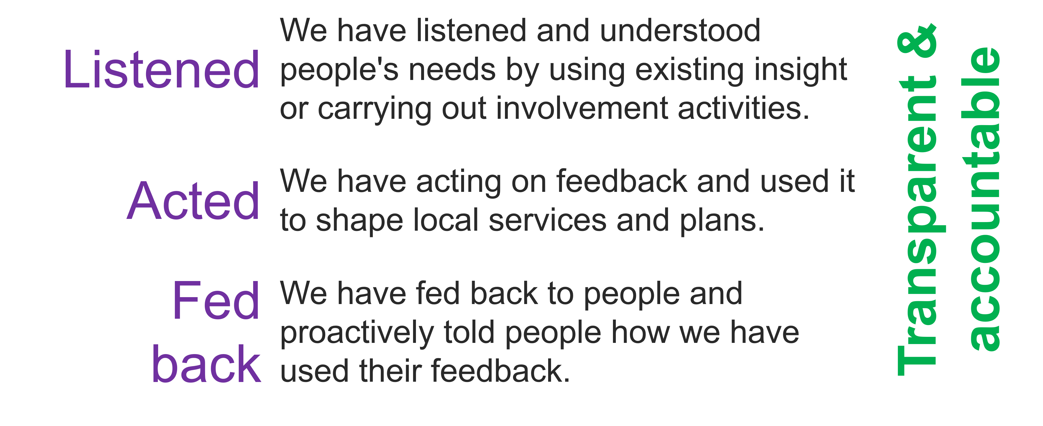
Public representation and assurance (2)
For the public to feel assured we need to demonstrate we have:

Slide 26
Public representation and assurance (3)
There are lots of ways we provide assurance that we have involved people in our work:
Insight reviews
Insight reports
Workshops
We want to continue and build on our public assurance work. This will involve working with our partners and local people to create new ways to represent the views of patients, their families and staff on our boards.

Slide 27
Public representation and assurance (4)
Groupwork
What do you think of the ways we are already involving people (insight reviews/workshops)?
What does public representation look like for you?
What would make you feel confident that we are listening, acting and feeding back?

Slide 28
Next steps
Evaluation of the session
Update insight report based on todays feedback
Use feedback to develop an approach to representation
Begin planning involvement on the gaps in our knowledge

Slide 29
Thank you

