Slide 1
Public Involvement Workshop
Frailty
Wednesday 11 Jan 2023 2:30 – 4:30

Slide 2
Recording
We are recording this session so that we can share the discussion with people who are unable to attend the meeting.
It will be available shortly on the Leeds Health and Care Partnership Website

Slide 3
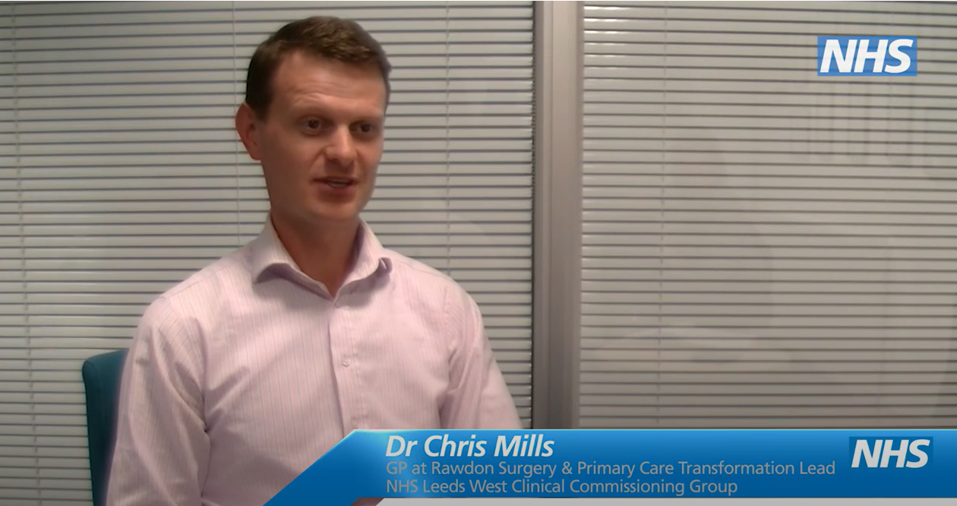
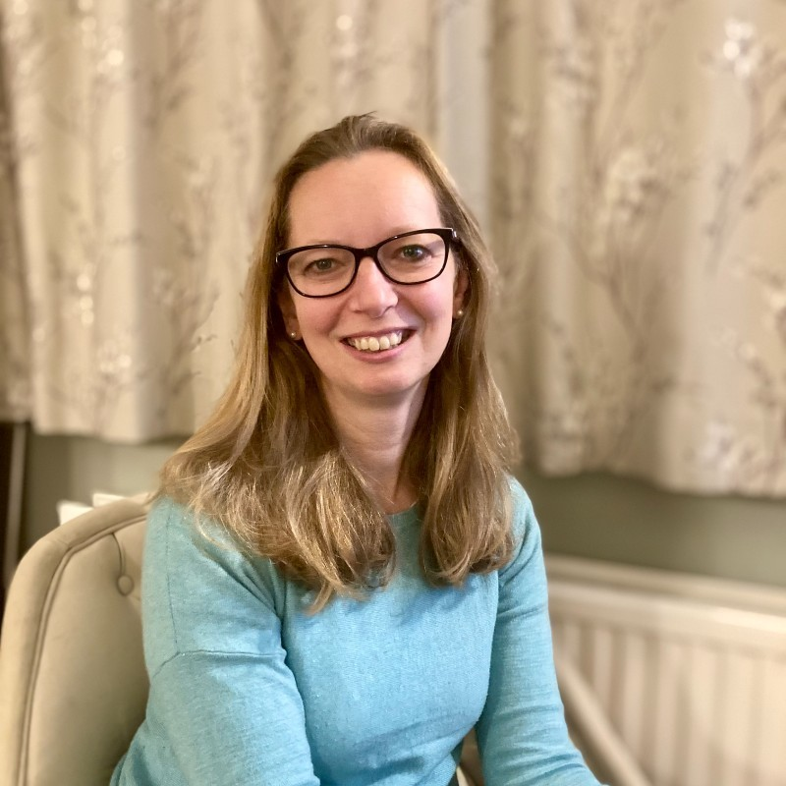
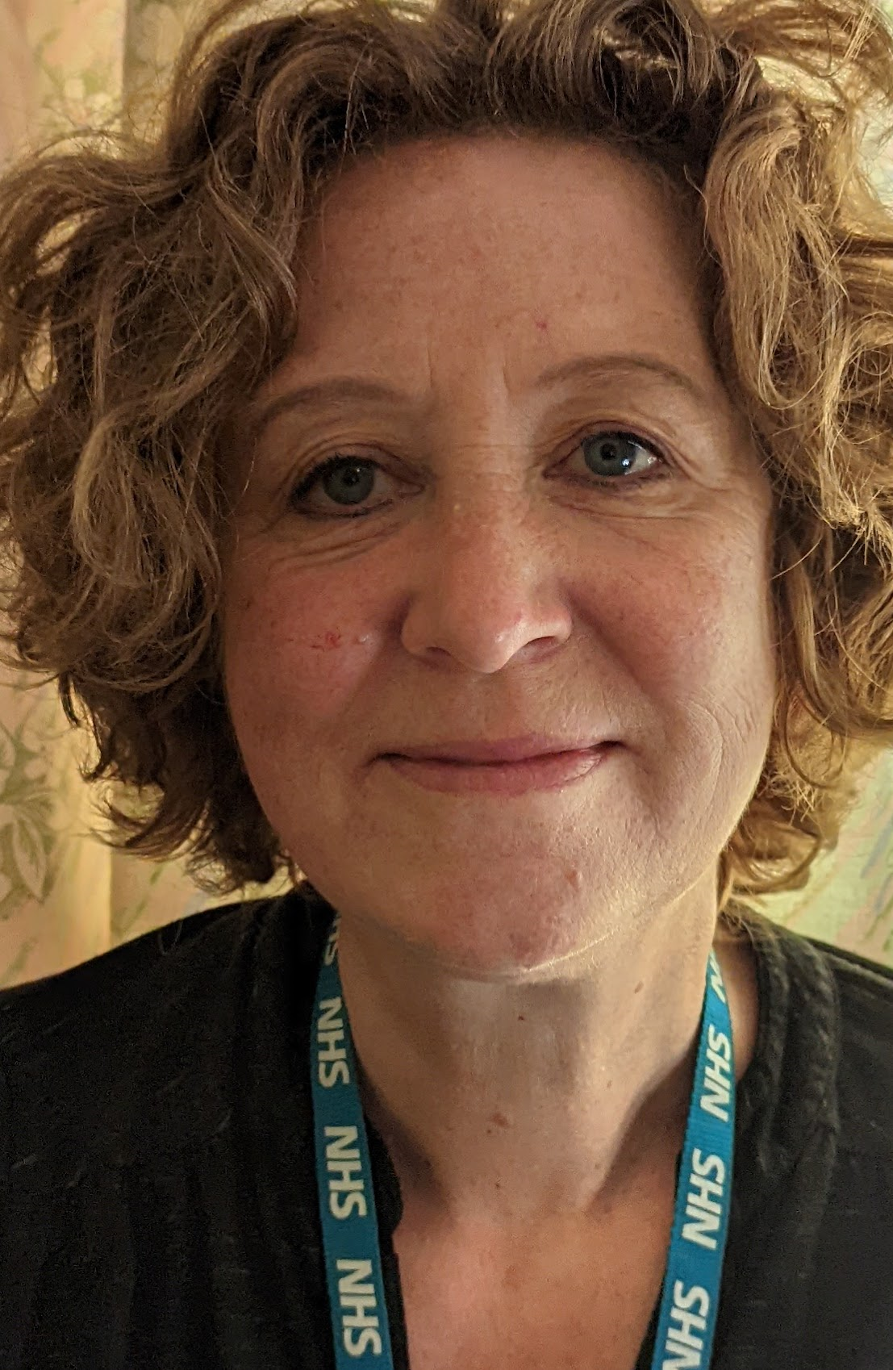
Welcome and Introductions
Chris Mills
GP and Chair of the Frailty Population Board
Helen Smith
Head of Pathway Integration (Frailty, Dementia and End of Life Care) NHS West Yorkshire Integrated Care Board (ICB) in Leeds
Caroline Mackay
Community Relations and Involvement Manager
NHS West Yorkshire ICB in Leeds

Slide 4
Aim and objectives
Aim
To help develop our approach to public involvement in the work of the frailty population board
Objectives
Introduce the population health approach and the frailty board
Review the findings of the insight report
Review and agree the draft outcomes for the board
Consider gaps in our findings and begin to think about addressing those
Agree how people's voice is represented at the board and provide public assurance

Slide 5
Outcomes of the workshop
By the end of the workshop participants should have had an opportunity to:
Understand the role of the frailty population board
Discuss the findings of the draft insight report
Influence the draft insight report
Discuss gaps in our findings
Suggest other areas of focus
Discuss the draft outcomes for the frailty board
Explore ways we can provide assurance that people's voices are heard at the board
Influence our approach to public representation and assurance on the board

Slide 6
Agenda
Population health - What are population boards and what is their role?
Experience of frailty - What do we already know about the experiences of people living with frailty and their families and carers? (insight)
Population outcomes - How do we want things to be different for people living with frailty and their families and carers? (outcomes)
Public representation and assurance – What does public representation look like on the board and how can we be assured that it's working?
Next steps - What happens next?

Slide 7
Ground rules
Stick to the agenda
Stay on mute unless you're speaking
Make space for everyone to speak
Have your say – use the hand signal or chat box to ask questions or share comments
Respect confidentiality
Enjoy the session!

Slide 8
Population health
As an approach, population health moves away from 'traditional' thinking about commissioning (planning and paying for) and providing health and care services.
It focuses less on organisations and pathways and more on the needs of the people, or populations, who use them.
It looks at:
The needs of people – what matters most to populations of people
Prevention – helping people stay healthy and well
Outcomes – the positive differences health care services and support can make
Reducing health inequalities
Working together in partnership rather than as individual organisations (system working)
The 'wider determinants of health' such as housing and transport
https://www.kingsfund.org.uk/publications/population-health-approach?gclid=EAIaIQobChMI8dWWp_ig-wIVCLbtCh2IKQ7REAAYASAAEgL2w_D_BwE

Slide 9
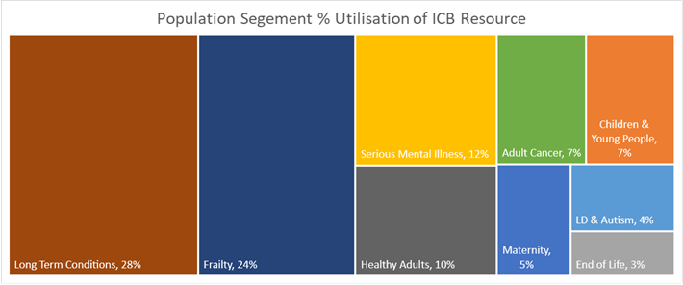
Population health
How the Leeds population would look if we divided it across our nine population boards, showing the level of need and percentage of resource for each.

Slide 10
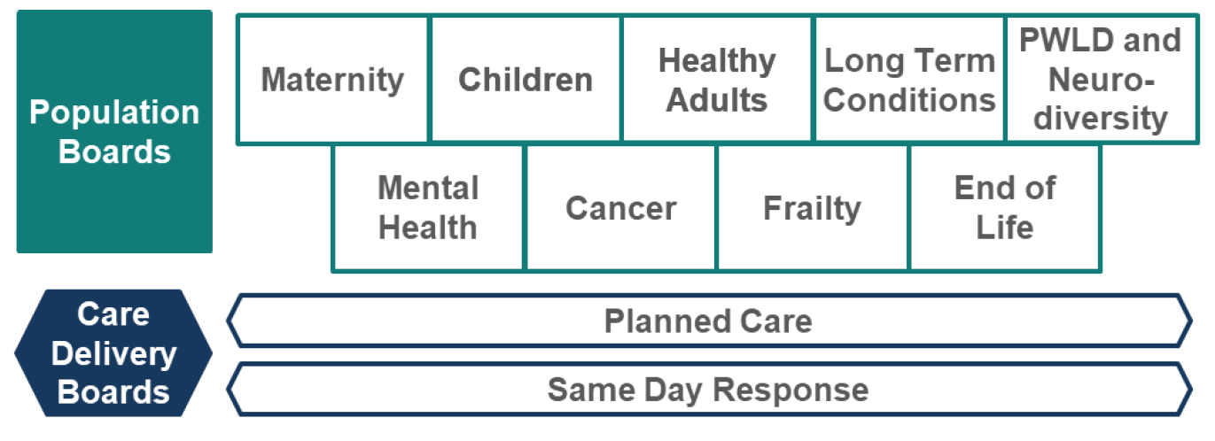
Population health
We aim to address these needs through a framework of nine population and two care delivery boards:
These boards are responsible for improving (or driving improvements in) the outcomes, experience, and the value of the NHS spend, for their respective population. They work across organisations and sectors with a clear focus on their population's particular needs.

Slide 11
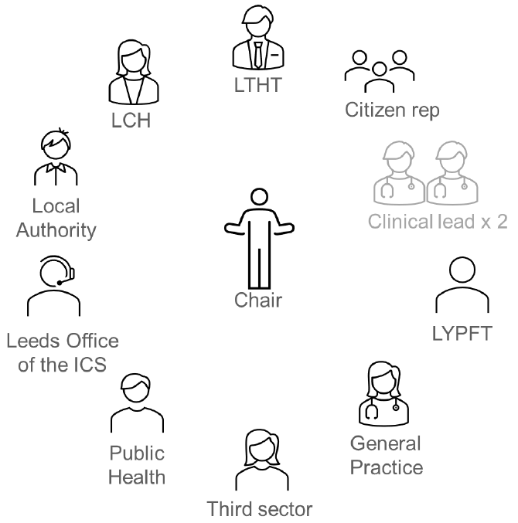
Population health
Boards are made up of senior representatives from across the health and care partnership including representatives from the third sector and from Healthwatch Leeds.
There is also space for 'citizen' or people's voice representation, which we are thinking about today.
The boards are:
Broad enough (to represent all partners)
Senior enough (to take critical decisions)
Small enough (to make these decisions)

Slide 12
Population health
The Frailty Population Board
Frailty is a term used by professionals to describe the loss of body resilience. This means that in the case of a physical or mental illness, an accident or other stressful event, people living with frailty will not bounce back quickly.
People living with frailty experience greater disability, hospitalisation, care home admission and mortality than patients who are not identified as frail.
Frailty is related to the ageing process, but not all older people are frail and not all individuals living with frailty are older. More about frailty can be found on NHS England’s website: www.england.nhs.uk/ourwork/ltc-op-eolc/older-people/frailty/
The Leeds frailty population board brings together partners from across the city to improve care, design more joined-up and sustainable frailty services and support, and make better use of public resources.
Webpage: www.healthandcareleeds.org/have-your-say/shape-the-future/populations/frailty/

Slide 13
Population health
What sort of decisions are the boards making?
Where to allocate funding
When to make changes to services
What the priorities are and how best to achieve the outcomes
What can be done to address health inequalities
How best to work with other boards and wider partners to avoid silo-working
How best to deliver value (value for money)
It is essential that local people's views are included in these decision-making processes.
This workshop builds on what we have learned so far about people's experiences of living with frailty in Leeds, and gives us an opportunity to begin to think about what how we can involve people more moving forward.

Slide 14
Population health
In Leeds we are aiming to commission (plan and pay for) and provide healthcare for populations of people, and their families and carers, that is:
Safe
Sustainable
Equitable and fair for all
Patient-centred
Value for money
We cannot do this without understanding the needs, preferences and experiences of people in each of the population segments.
We are committed to 'starting with what we know' about people's experiences, listening to what matters most to our population, and engaging on the gaps in our knowledge and understanding.

Slide 15
Experience of frailty
The board is working with partners to establish what we already know (by carrying out an insight review) about the experiences of local people living with frailty, their families and their carers.
Our findings to date have been collected into an insight report which will be used by the board as a developing evidence base, to learn more about the needs of this population and to make more informed decisions as a result.
The insight report:
Outlines what we already know about people's needs, preferences and experiences of living with frailty in Leeds
Identifies key themes (the things people often tell us about their care)
Highlights gaps in our knowledge (e.g. the areas or communities whose experiences we know least about)

Slide 16
Experience of frailty
Our insight review for frailty suggests the following themes:
Compared with other populations, those living with frailty were less likely to receive person centred coordinated care.
Compared with other populations people living with frailty were more likely to feel that they were only sometimes able to discuss what was important to them in managing their own health and wellbeing (involvement in care).
Those living with frailty were more likely to report instances where they were required to repeat information within and between services (Communication/joint working).
People had mixed views on the word ‘frailty’. Carers generally found the word helpful but many people living with frailty told us that the word had negative connotations
Data suggests that the frailty population currently does not receive enough support or information to help them manage their own health and wellbeing, such as diet and up-to-date health information.
Older people (who are more likely to experience frailty) tell us that wider determinants such as housing and access to social activities and exercise have a significant impact on their health and well-being.
Accessible and safe travel and transport is seen as important by people living with frailty and their carers. (Health inequality – age).

Slide 17
Experience of frailty
Themes continued:
The proportion of people living with frailty is three times higher in the most deprived areas of Leeds than least deprived (health inequality – deprivation).
Living at home for as long as possible and living with dignity and independence is seen as very important by people living with frailty (Choice and support).
People living with frailty report the importance of having services that work well together but take collective accountability (Joint working).
Older people value a workforce that has a good understanding of the needs and preferences of older people.
Fear of falling significantly impacts on people living with frailty. They value support with this (environment/resources).
Support for visual impairments is important to people living with frailty, in particular support accessing visual aids, good physical access and understanding staff (Health inequality – disability and workforce).
COVID-19 had a significant impact on people with frailty including an impact on confidence and isolation.
Health inequality (race and deprivation) - People from diverse ethnic communities in the most deprived areas become frail 11 years younger than white people in the least deprived areas
Resources - Carers told us that independence for them meant being in control of their life. Access to respite care was seen as important my many of the carers we spoke to.

Slide 18
Experience of frailty
Our insight review for frailty suggest the following gaps:
Feedback from staff working with people living with frailty
Additional gaps and considerations identified by stakeholders:
????

Slide 19
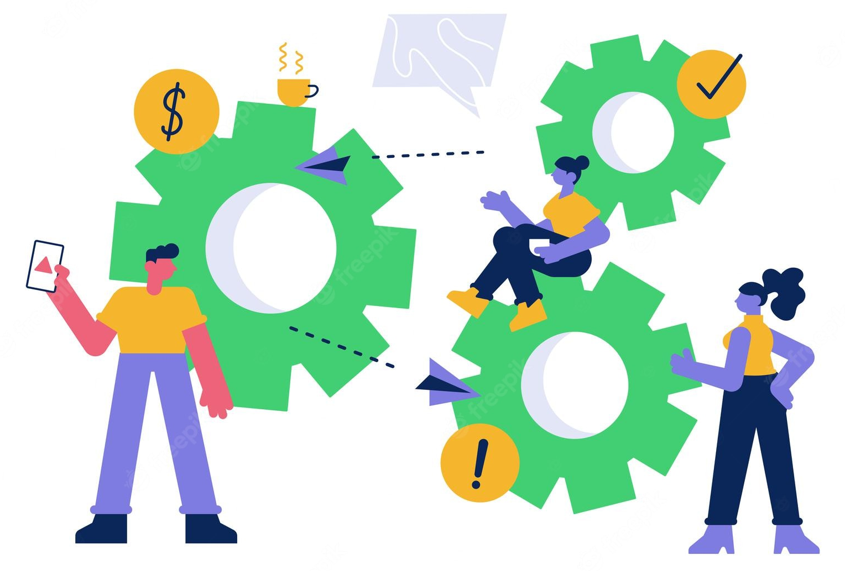
Experience of frailty
Discussion
Do you agree with the main themes we have found?
What about gaps… where else should we be looking, or who should we be talking to?
How do we prioritise and plan involvement work on the gaps?
What matters most to people living with frailty, their families and carers?

Slide 20
Population outcomes
Over the last year we have been working with our partners to agree a set of outcomes for our frailty work in Leeds. These outcomes explain what we as a board, and as a health and care partnership, want to achieve to improve the experiences of people living with frailty and their carers, families and friends.
The outcomes have been developed with healthcare service providers and voluntary sector organisations that work alongside people using frailty services and support. The outcomes were shaped used patient, carer, family and staff feedback from various surveys and involvement activities.

Slide 21
Population outcomes
Draft outcomes for frailty in Leeds
Live and age well, defined by ‘what matters to me’.
Identifying and supporting all people in this population group, and assessing their needs and their assets, as an individual and as a carer.
Reducing avoidable disruption to people’s lives as a result of contact with services.

Slide 22
Population outcomes
Outcomes are linked to the Healthy Leeds Plan (which sets out how we will work together as a city to improve outcomes for everyone in Leeds).
Each one has a set of measures which will help us to see if we are on track to achieving our outcomes.

Slide 23
Population outcomes
Discussion
Do these outcomes make sense to you?
Do they reflect what matters to you/your family/the people you represent?
How would you like us to demonstrate improvements against these outcomes?

Slide 24
Public representation and assurance
As an organisation, we have a legal and a moral duty to involve people in the plans and decisions we make about the provision of healthcare in Leeds.
It's important that patients, carers and the wider public are aware, and assured, that we are working to ensure that people's voices and experiences are at the heart of our decision-making, and that people feel that their voices and experiences are being properly represented.
We need to be able to show that this is happening so that people can be assured that their input and feedback is helping shape and improve local services and support.
We call this providing 'public assurance'.

Slide 25
Public representation and assurance
For members of the public to feel assured we need to demonstrate we have:
Listened | We have listened to people by using existing insight or carrying out involvement activities | Transparent & accountable
Acted | We have acted on feedback and are using it to shape local services and plans.
Fed back | We have fed back to people and have proactively let people know how we have used their feedback

Slide 26
Public representation and assurance
There are various ways people's voice and experience can be taken into account by the board:
By an individual
By a sub-group which runs parallel to the board
By links with a particular group or organisation
By increasing feedback to services directly
Our work to strengthen public assurance is ongoing – today we are keen to hear your thoughts on how the voices and experiences of people living with frailty and their families and carers would be best represented at the board.

Slide 27
Public representation and assurance
Discussion
What do you think of the ways we are already involving people (insight reviews/workshops)?
What would good public representation look like for you?
What would make you feel confident that we are listening, acting and feeding back?

Slide 28
Next steps
Add a copy of this recording to the frailty webpage:
Frailty - Leeds Health and Care Partnership (healthandcareleeds.org)
Send out slides and an evaluation survey of the session
Update the insight report based on today's feedback
Use today's feedback to help develop our approach to representation
Begin looking at the gaps in our knowledge and think about involving people to help us learn more. Please send any additional insight or comments to chris.bridle@nhs.net
Organise a follow-up meeting?
Thank you for joining our session – it is very much appreciated!

Slide 29
Thank you!

