Slide 1
Public Involvement Workshop
End of Life Care
Nov 2022

Slide 2

Recording
We are recording this session so that we can share the discussion with people who are unable to attend the meeting.
It will be available shortly on the Leeds Health and Care Partnership Website

Slide 3
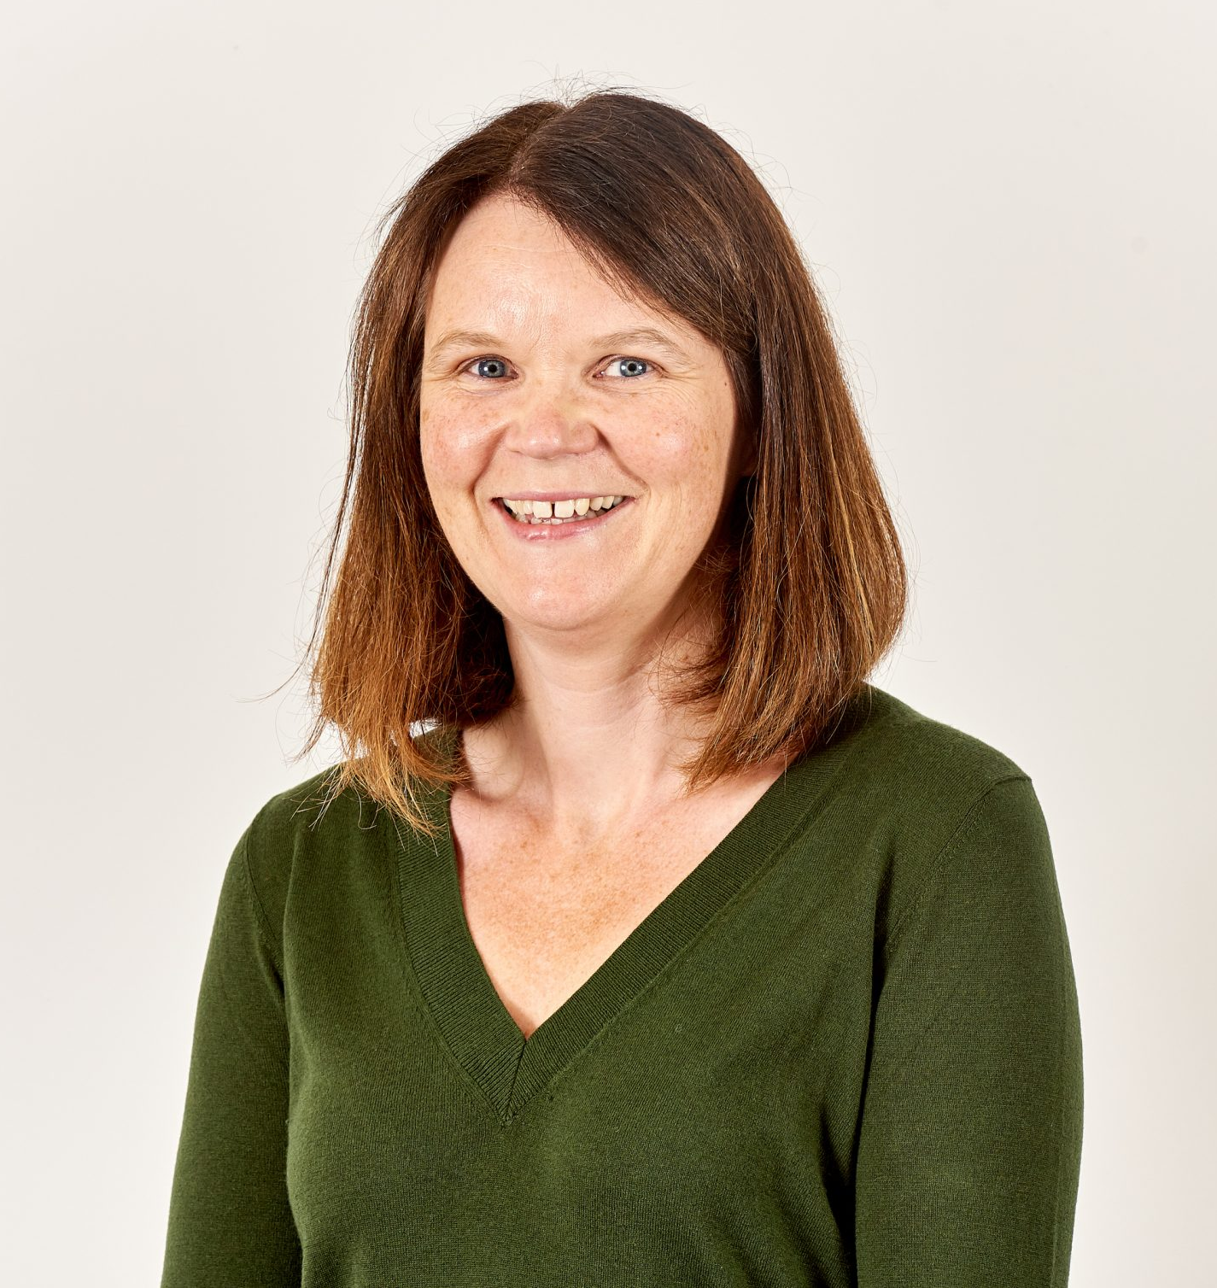
Welcome and Introductions
Gill Pottinger
GP and chair of the End of Life Care Board

Slide 4
Aim and objectives
Aim
To develop our approach to public involvement in the population board
Objectives
Introduce population health and the board
Review and agree the findings of the insight report
Review and agree the draft outcomes for the board
Begin planning involvement on the gaps in our knowledge
Agree how we represent people at the board and provide public assurance

Slide 5
Outcomes of the workshop
By the end of the workshop participants should have had an opportunity to:
Understand the role of the board
Discuss the findings of the draft insight report
Influence the draft insight report
Discuss gaps in our knowledge
Suggest other gaps
Discuss the draft outcomes for end of life
Explore ways we can provide assurance that people's voices are heard at the board
Influence our approach to public representation and assurance on the board

Slide 6
Agenda
Population Health - What are population health boards and what is their role?
Experience of end of life care - What do we know about the experiences of people at end of life care and their family? (our insight)
Population outcomes - How do we want things to be different for people at end of life and their families? (our outcomes)
Public representation and assurance – What does public representation look like on the board?
Next steps - What happens next?

Slide 7
Groundrules
Stick to the agenda
Be honest
Be open to new ideas
Listen to others
Respect confidentiality
Don’t judge
Enjoy

Slide 8
Population health
Population health moves away from 'traditional' thinking about commissioning (planning and paying for) and providing services.
It thinks less about organisations and pathways and more about people, or 'populations'.
It focuses on:
The needs of people – what is important to people
Prevention – helping people stay well
Outcomes – the difference care makes
Reducing health inequalities
Working as partners rather than as organisations (system working)
The 'wider determinants of health' such as housing and transport
https://www.kingsfund.org.uk/publications/population-health-approach?gclid=EAIaIQobChMI8dWWp_ig-wIVCLbtCh2IKQ7REAAYASAAEgL2w_D_BwE

Slide 9
Population health
How the Leeds population would look if we organised by need.

Slide 10
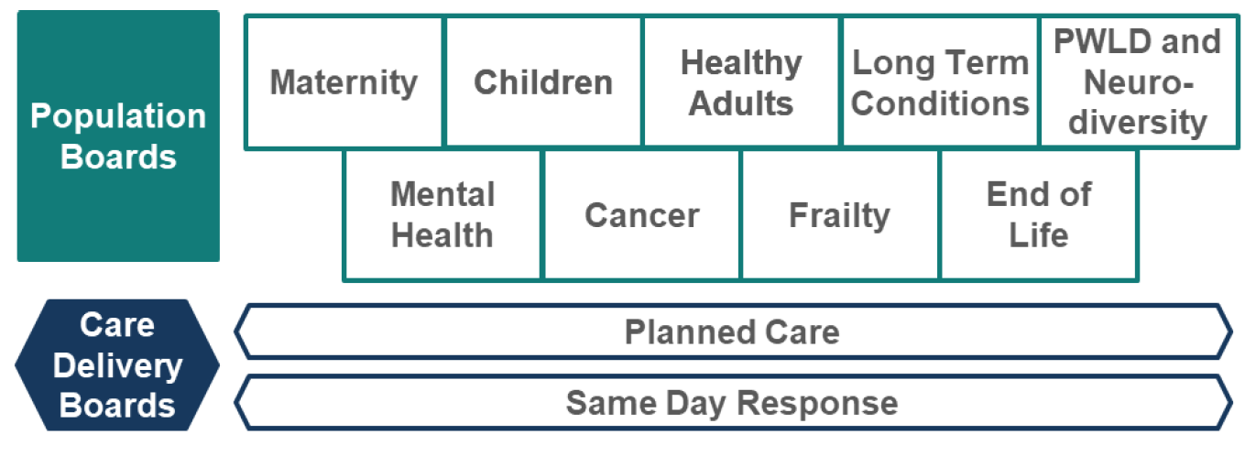
Population health
How we will meet these needs in Leeds?
These boards are responsible for improving (or driving improvements in) the outcomes, experience and value of NHS spend for their respective population…
Working across organisations, across sectors, and focussed on people's needs.

Slide 11
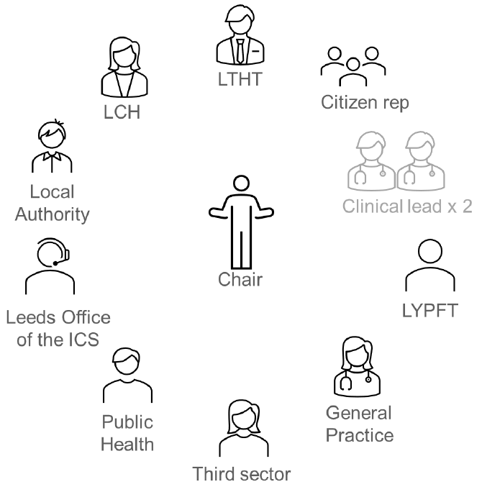
Population health
Boards will be made up of senior representatives from across the health and care partnership.
The boards will be
Broad enough (to represent all partners)
Senior enough (to take critical decisions)
Small enough (to make these decisions)

Slide 12
Population health
The End of Life Population Board
End of life care is defined as care that:
“helps all those with advanced, progressive and incurable illness to live as well as possible until they die. It enables the supportive and palliative care needs of both patient and family to be identified and met through the last phase of life and into bereavement. It includes the management of pain and other symptoms and provision of psychological, social, spiritual and practical support” (DH, 2008).
Palliative care is defined as:
“The active holistic care of patients with advanced progressive illness. It is the management of their pain and other symptoms together with the provision of psychological, social and spiritual support” (National Council for Palliative care)

Slide 13
Population health
What sort of decisions will the boards make?
Where to allocate funding
When to make changes to services
What the priorities are
How to deliver value (value for money)
It is essential that we involve people in this decision-making process. This workshop builds on our involvement so far and gives us an opportunity to plan future involvement together.

Slide 14
Experience of end of life care
In Leeds we want to commission (plan and pay for) and provide care that is:
Safe
Sustainable
Patient-centred
Value for money
We cannot do this without understanding the needs, preferences and experiences of people in our population.
We are committed to 'starting with what we know' about people's experiences and engaging on the gaps in our knowledge.

Slide 15
Experience of end of life care
Each population board in Leeds is working with partners to review what we already know (an insight review). Our findings will be written into an insight report which will be used by the board to understand the needs of the population and make decisions.
The insight report will:
Look at what we already know about people's needs, preferences and experiences
Identify the key themes (the things people often tell us about their care)
Highlight the gaps in our knowledge (the areas or communities we know least about)

Slide 16
Experience of end of life care
Our insight review for end of life care suggest the following themes:
People are generally satisfied with their experience of using services end of life services and support.
Person centred care is very important to people and the majority of people in Leeds report receiving kind, compassionate care.
People at end of life and their carers/family/friends value kind and compassionate staff and the majority of people are very happy with the workforce in Leeds
Information about services and support for people at end of life is sometimes poor and inconsistent
Some people tell us that health and care services and support at end of life were often not joined up.
Privacy and dignity is very important to people at end of life and their carers/family/friends (environment)
People at end of life and their carers/family/friends from diverse ethnic communities had views consistent with the wider population. However, they reported having particular difficulties accessing an interpreter (health inequalities)
The health need assessment in 2019 highlights some variation in experience and a need for improvement, especially amongst the following groups, diverse ethnic communities, people from areas of deprivation, men and people under 65.
There are some potential gaps in our insight including feedback from staff and the needs of families and friends of people who die suddenly.

Slide 17
Experience of end of life care
Our insight review for end of life care suggest the following gaps:
Ethnically diverse communities (in particular people whose first language is not English
some areas of deprivation,
men,
people under 65.
Feedback from staff working with people at end of life
Additional gaps and considerations identified by stakeholders
Inequalities in death. (Carers Leeds)
Needs of carers/families/friends of people who die relatively unexpectedly? (Carers Leeds)
Practical support needs and preferences of people at the end of life, particularly if they want to die at home? (Carers Leeds)
How we talk about death and dying as a community, compassionate communities and the practical support that people need when they wish to die at home (Local Care Partnerships Development Team)

Slide 18

Experience of end of life care
Groupwork
Do you agree with the themes and gaps?
Have we missed any themes or gaps in our insight?
How do we prioritise and plan involvement work on the gaps?

Slide 19
Population outcomes
Over the last year we have been working with our partners to agree a set of outcomes for end of life care in Leeds. These outcomes explain what we want to achieve to improve the lives of people at end of life and their carers, family and friends.
The outcomes have been developed with service providers and voluntary sector organisations that represent people using end of life services. The outcomes were shaped used patient, carer, family and staff feedback from various surveys and involvement activities.

Slide 20
Population outcomes
Draft outcomes for end of life care in Leeds
People approaching the end of their life are recognised and supported on time
People approaching the end of life live and die well according to what matters to them
All people approaching the end of life receive high quality, well-coordinated care at the right place at the right time and with the right people
People approaching the end of life and their carers are able to talk about death with those close to them and in their communities. They feel their loved ones are well supported during and after their care.

Slide 21
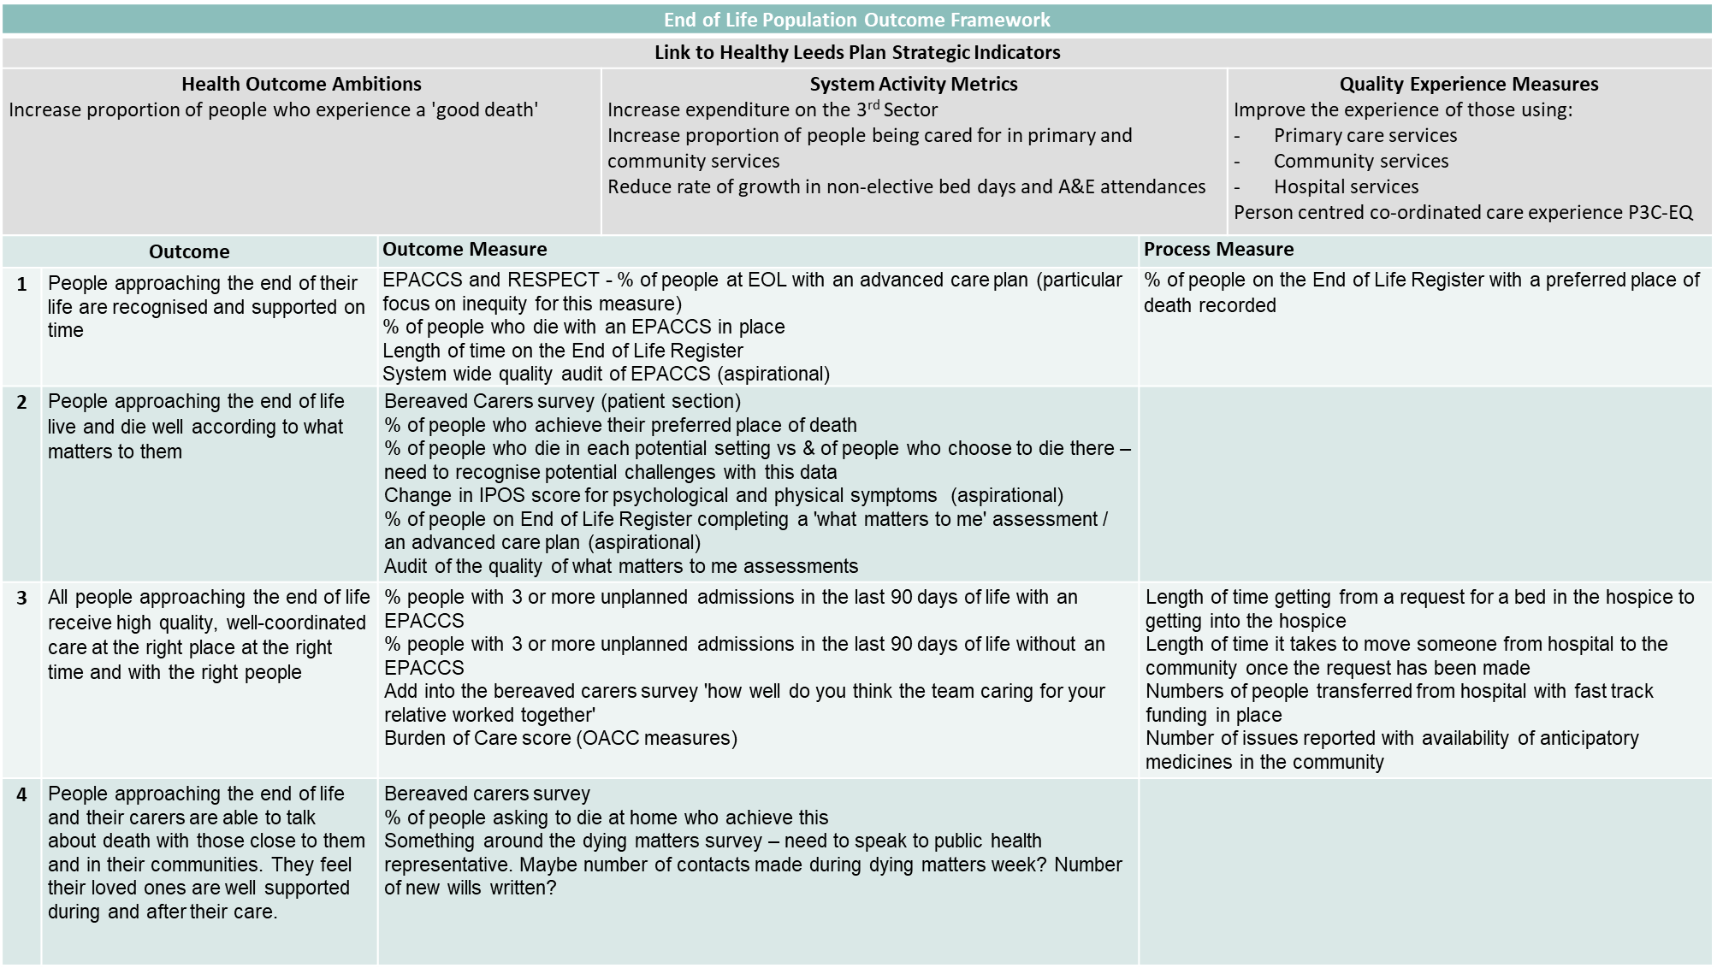
Population outcomes
Each outcome has a set of 'measurables'. These are things we will use to measure whether we have achieved our outcomes.

Slide 22
Population outcomes
Groupwork
Do you understand these outcomes?
Do the outcomes reflect what matters to you/your family/the people you represent?
How would you like us to demonstrate improvements against these outcomes?

Slide 23
Public representation and assurance
We have a legal and a moral duty to involve people in the decisions we make.
We want patients, carers and the public to be assured that we are putting people at the heart of our decision-making. We call this approach 'public assurance'.

Slide 24
Public representation and assurance
For the public to feel assured we need to demonstrate we have:
Listened | We have listened to people by using existing insight or carrying out involvement activities | Transparent & accountable
Acted | We have acting on feedback and used it to shape local services and plans.
Fed back | We have fed back to people and proactively telling people how we have used their feedback

Slide 25
Public representation and assurance
There are lots of ways we provide assurance that we have involved people in our work:
Insight reviews
Insight reports
Workshops
We want to continue and build on our public assurance work. This will involve working with our partners and local people to create new ways to represent the views of patients, their families and staff on our boards.

Slide 26
Public representation and assurance
Groupwork
What do you think of the ways we are already involving people (insight reviews/workshops)?
What does public representation look like for you?
What would make you feel confident that we are listening, acting and feeding back?

Slide 27
Next steps
Evaluation of the session
Update insight report based on todays feedback
Use feedback to develop an approach to representation
Begin planning involvement on the gaps in our knowledge

Slide 28
Thank you

