Slide 1


Leeds patient training
Patient participation groups:
Making your PPG meaningful and productive
Lisa Kundi – Primary Care Locality Manager
Chris Bridle – Engagement Lead
December 2016 V2.1

Slide 2
Housekeeping
Introductions
Timing of session
Breaks
Toilets
Fire alarm

Slide 3

Groundrules
Stick to the agenda
Be honest
Be open to new ideas
Listen to others
Respect confidentiality
Don’t judge
Enjoy

Slide 4
Aims and objectives of the session
Aim
‘To empower and inspire PPG members so that they can influence the development of local health services’
Objectives
To introduce the patient champion’s role
To outline the UK healthcare system and the role of CCGs
To introduce primary care and its place in the NHS
To outline the key challenges to CCGs and primary care
To introduce the primary care initiatives in Leeds
To outline the history and role of the PPG
To outline the characteristics of effective PPGs
To introduce tools and resources to support PPGs
To explore opportunities for patient groups to influence the decision making process

Slide 5
Outcomes
By the end of the session participants will:
Understand the patient champion’s role
Recognise the key organisations in the NHS
Be able to explain the role of primary care
Understand the key challenges to primary care
Be able to outline the some of the solutions to the challenges
Be able to talk about the characteristics of effective PPGs
Know what tools are available to support their PPG
Have the opportunity to share good practice
Be able to explain how patient champions can influence the decision-making process in primary care

Slide 6
Agenda
An introduction to patient champions
The UK healthcare system
The role of primary care
Comfort break
The case for change
The role of the CCG
The role of the patient group in primary care

Slide 7

Icebreaker
Fried Egg
In small groups consider the things you have in common and the things you don’t.
Write anything you share in the yoke
Write anything that’s different about you in the egg white

Slide 8
1. An introduction to patient champions The value of engagement
‘Internationally, PPE is increasingly seen to enhance all healthcare, by being a marker of services that are oriented, planned and delivered towards patient interests. The involvement of patients provides a different perspective from that of clinicians.’
Patient and Public Engagement (PPE)
PPE in Clinical Audit 2009
Healthcare Quality Improvement Partnership
http://www.hqip.org.uk/assets/PPE/HQIP-A-guide-to-developing-a-patient-panel-for-clinical-audit-Feb-2014.pdf

Slide 9
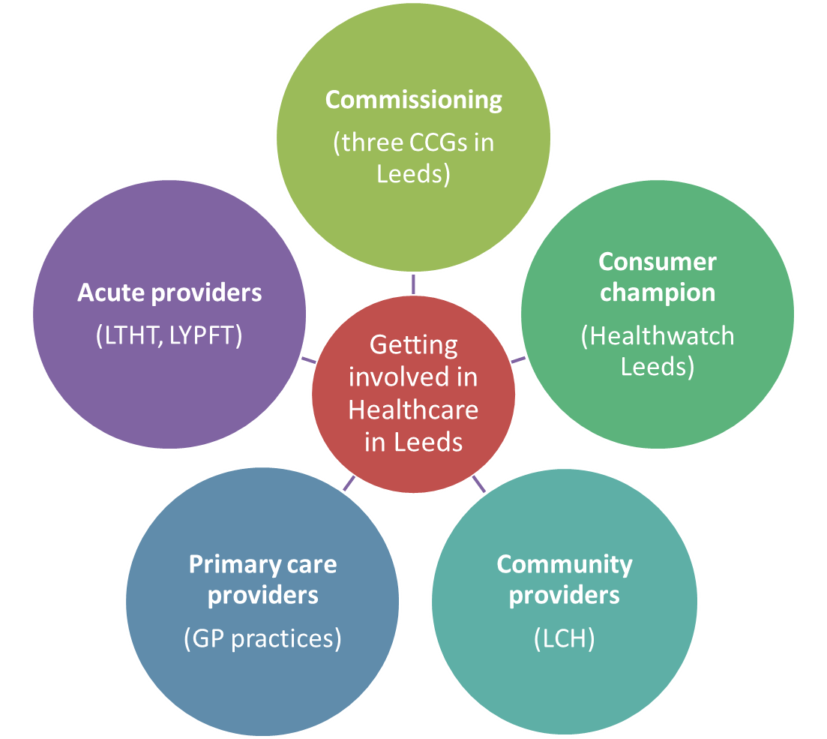
1. An introduction to patient champions Involvement in Leeds
Places to get involved
in healthcare

Slide 10
1. An introduction to patient champions Involvement in Leeds
Ways to get involved in healthcare in Leeds
As an individual (sharing your personal opinion) | Friends and family test Filling in surveys about service change Filling in surveys about your GP practice Patient Opinion/NHS Choices (Complaints or compliments) Attending focus groups Patient Participation Groups (PPG)? | Both are valid engagement roles
As a ‘patient champion’ (championing the needs of the wider community) | Patient Participation Groups (PPG)? Patient Assurance Groups (PAG) ‘Patient champion’ on a steering group

Slide 11
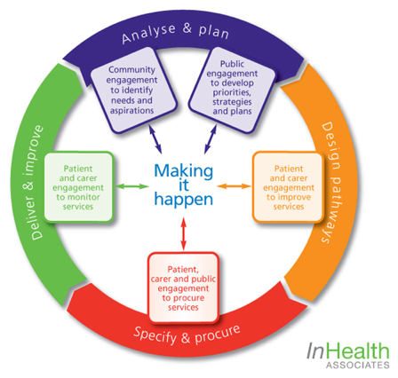
1. An introduction to patient champions Why patient champions?
Lots of evidence about the value of involving patients
It’s a statutory duty to involve patients
We need to involve patients at every stage of the commissioning cycle

Slide 12
1. An introduction to patient champions What is a patient champion?
‘Patient leaders are patients, service users and carers who work with, and for others to influence decision-making at a strategic level’
Centre for Patient Leadership
http://engagementcycle.org/wp-content/uploads/2013/03/Bring-it-on-40-ways-to-support-Patient-Leadership-FINAL-V-APRIL-2013.pdf

Slide 13

1. An introduction to patient champions What is their role?
Patient champions
Patients, carers and the public
Commissioners and providers

Slide 14

1. An introduction to patient champions What is their role?
It isn’t to:
Promote a personal campaign
Criticise existing services/processes
It is to:
Contribute to improving services
Ensure that we consider feedback from patients
Be open-minded
Understand the health needs of the wider public
Champion the needs of the wider public
Ensure that we act of the feedback of patients/public
Share the responsibility for difficult decisions
Focus on improving patient experience
Support the engagement

Slide 15

1. An introduction to patient champions How do we support them?
By providing access to:
engagement reports
patient experience data
patient reader group
training
peer support
the comms and engagement team
‘Engaging Voices’
social media

Slide 16
1. An introduction to patient champions Who are patient champions?
Patients, carers and members of the public
People interested in improving services
People from our patient network
People involved in our engagements
People from the VCF sector
People from Healthwatch
People from all the CCGs
People from PRGs
Different people
Objective people

Slide 17
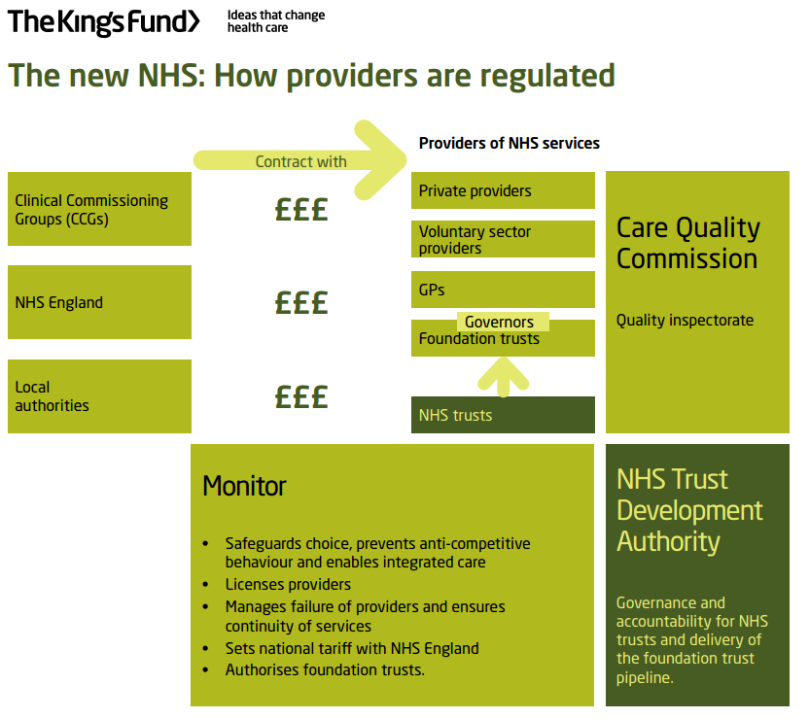
2. The UK healthcare system Providers and commissioners
Commissioners plan and pay for healthcare services.
Providers deliver the service that has been commissioned.
Regulators make sure that NHS services are high quality.

Slide 18
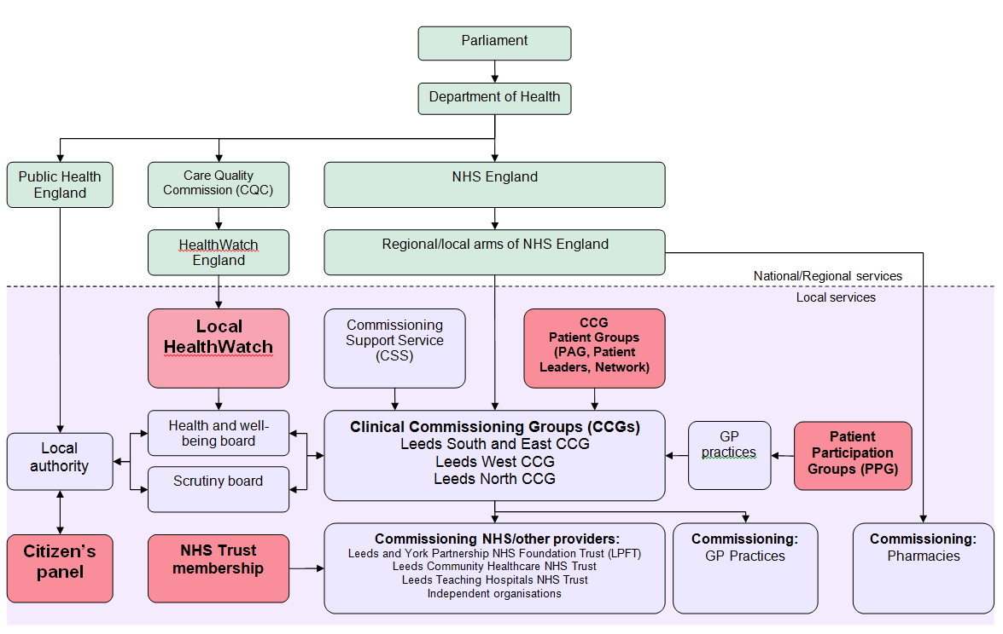
2. The UK healthcare system Providers and commissioners

Slide 19
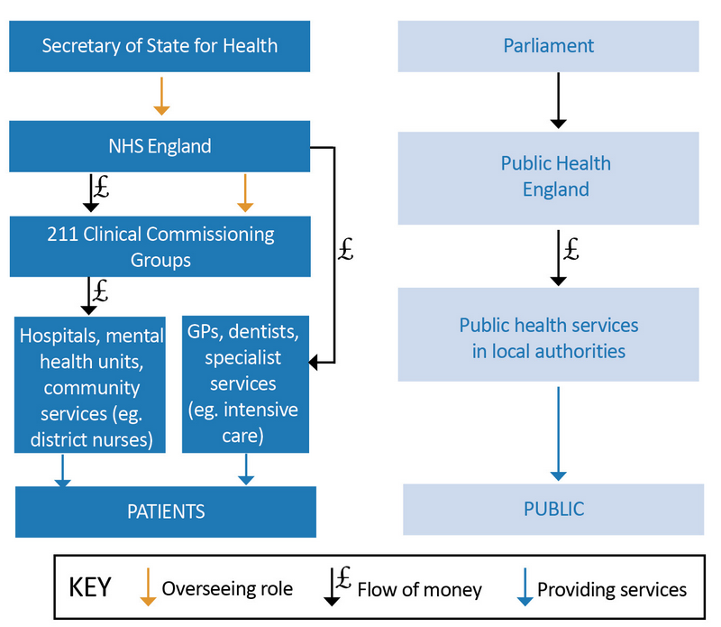
2. The UK healthcare system The role of Clinical Commissioning Groups
Clinical Commissioning Groups (CCGs) are one of the commissioners of healthcare in the country
CCGs are made up of groups of GP practices (they are ‘clinically led’)
CCGs commission healthcare in Leeds.
They plan and pay for hospital, community and GP healthcare in the city
There are three CCGs in Leeds

Slide 20
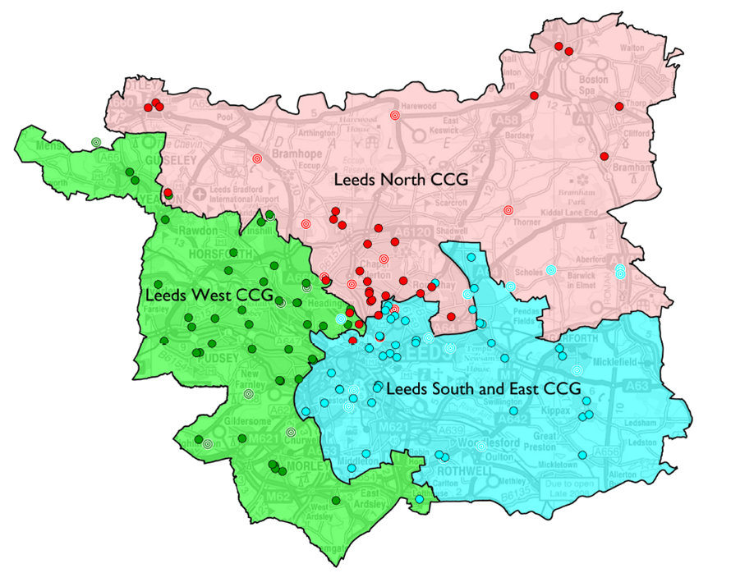
2. The UK healthcare system Clinical Commissioning Groups in Leeds
Three Clinical Commissioning Groups in Leeds
Creating
Conditions for
Good things to happen
Investing in future of primary care
Longer term planning & funding
Trusting clinicians
Empowering patients
Innovating through technology

Slide 21
3. The role of primary care What does primary care mean to you?
Groupwork
As one large group think about what primary care means to you.
Which organisations make up primary care?
What staff work in primary care?
What is it’s role?
What words come into your head when you think of primary care?

Slide 22




3. The role of primary care What is primary care?
“Collective term for services provided in the community such as General Practice, Community Pharmacies, Optometrists and Dentists”

Slide 23
3. The role of primary care Who does what in healthcare?
Primary care is responsible for 90% of patient contact

Slide 24
3. The role of primary care General practitioners
GPs work with a team of health professionals
Practice managers
Practice nurses
Healthcare assistants
Health visitors
Receptionists and admin staff
Locum GPs
GP registrars

Slide 25
3. The role of primary care General practitioners
A good practice provides access to a wide range of healthcare services to help address local health needs and inequalities. The services provided by GPs are split into three groups:
Essential services
GP consultations
Asthma clinics
Additional services
Practices are expected to provide additional services but can choose not to. Additional services include; contraceptive and maternity services
Enhanced services
Enhanced services are essential or additional services that are delivered to a higher standard, or extra, more specialised services. Specialised services can cover health issues such as substance misuse, depression or multiple sclerosis or particular groups such as, the homeless, immigrants.
Other services
Some practices can also offer other, complementary services. Whilst these services do vary between practices, they can include; Counselling or dermatology

Slide 26
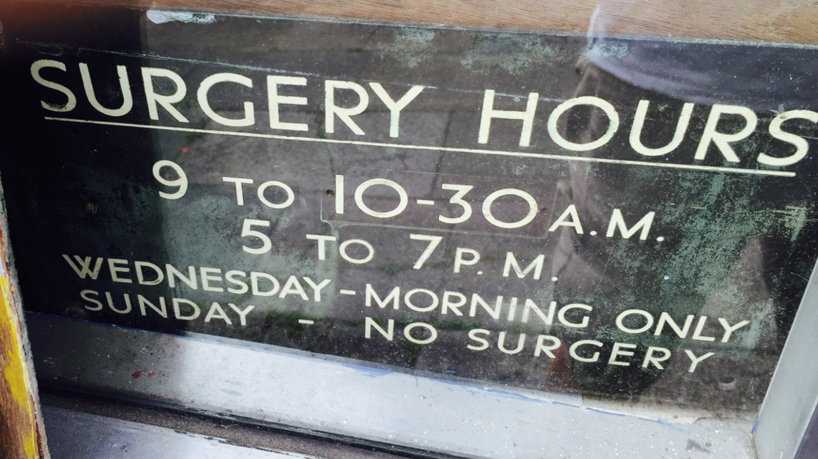
3. The role of primary care General practitioners
The cornerstone of the NHS
Independent contractors (small businesses)
Treating and onward referral
Registered list
One million people every day.
Generally high satisfaction rates:
Local
Family doctor

Slide 27


Slide 28
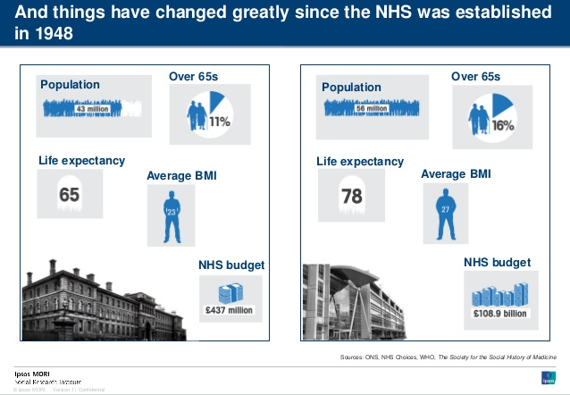
4. The case for change How things have changed
Population increase of over 13 million
5% more over 65s
Living 13 years longer
Increase in obesity

Slide 29
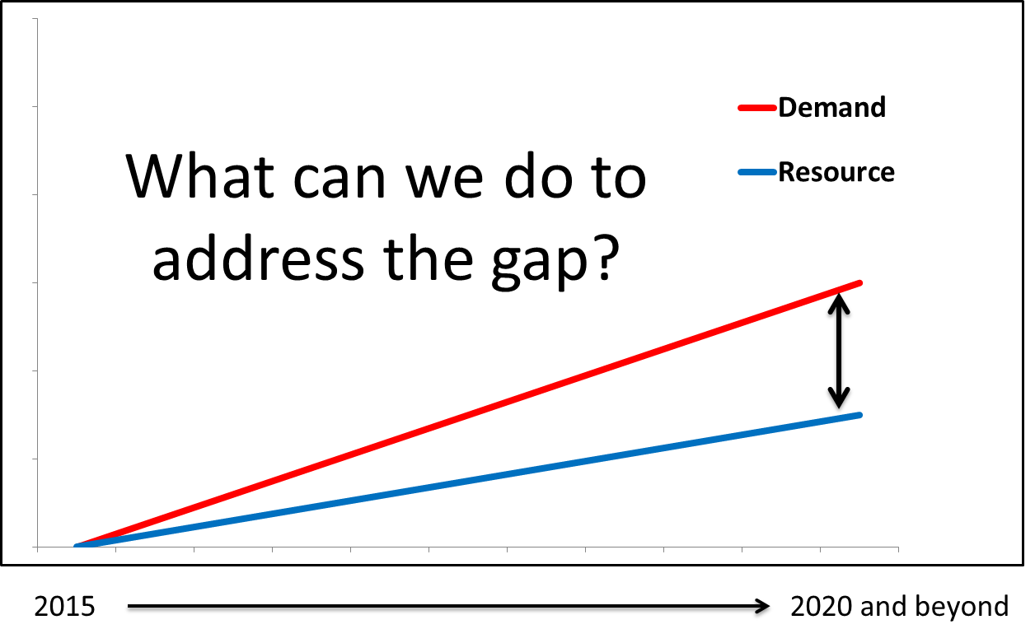
4. The case for change The resource/demand gap

Slide 30
5. The role of the CCG Challenges for the CCG and primary care
What do you think are the key challenges to primary care in 2017?
High quality
Accessible
Safe
Rising complexity of long term conditions
Variation in practice
New commissioning landscape
Patient expectations
Financial constraints
Workforce and workload
External assessment

Slide 31
5. The role of the CCG The approaches to primary care in Leeds
Enhanced access - GPs opening seven days a week
Technology- New and innovative ways to access GPs (Skype, online services etc)
Co-commissioning - More CCG involvement in commissioning GPs
Year of care - Personalised care planning
Workforce and education - Develop primary care staff
Social prescribing - Referring patients for social and emotional support
GP practices working together - Practices working as part of a ‘network’

Slide 32
6. The role of the PPG in primary care
‘……to ensure that patients are involved in decisions about the range and quality of services provided and, over time, commissioned by their practice.’
BMA, 2011

Slide 33
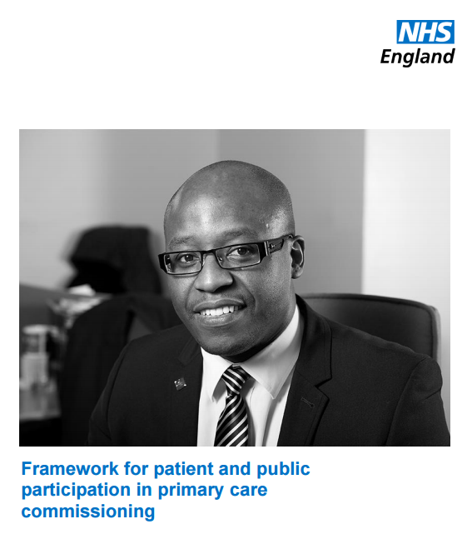
6. The role of the PPG in primary care
A framework for participation
Primary care servicers are for everyone – focus on seldom heard communities
Patients should be involvement at all stages of commissioning cycle
NHS England and CCCs to work in partnership
Bespoke participation and involvement
Keep records of participation esp. impact
Plan for participation (budget, impact)
Involve people early
Work with other partners – VCFS
Feedback
https://www.england.nhs.uk/commissioning/wp-content/uploads/sites/12/2016/03/framwrk-public-partcptn-prim-care.pdf

Slide 34
6. The role of the PPG in primary care
Patient participation in the GP contract 2015
Patient Participation Directed Enhanced Service (DES) was created in 2011
Gave practices additional funding to set up Patient Participation Groups
The PP DES ended in March 2015
It remains a contractual requirement that practices have a PPG
It is an expectation for CQC assessments that practices have a PPG
No prescriptive requirements on how to run a PPG
No reporting requirements

Slide 35
6. The role of the PPG in primary care
The characteristics of a productive PPG
Groupwork
In small groups use the PPG quality indicator to review your PPG.

Slide 36
6. The role of the PPG in primary care
The characteristics of a productive PPG
Have a clear terms of reference
Have clear ground rules
Have a clear action plan
Well chaired
Are valued by the practice
Have access to patient feedback/experience about the practice
Are regularly attended by a range of staff
Meet regularly
Is reasonably accessible
Have members who are objective
Focus on improvement of quality of care and patient experience
Have the opportunity to explore solutions in a safe and transparent environment
Consider the views of people not represented on the group
Work in partnership with staff and the VCF sector
Can see how their contributions have impacted on patients

Slide 37
6. The role of the PPG in primary care
What skills and knowledge do PPG members need?
Listening skills
Emotional intelligence
Basic understanding of the healthcare system
Conflict management
Asking difficult questions
Empathy
Ability to be objective
Knowledge of the local community
Experience of using the practice

Slide 38
6. The role of the PPG in primary care
What support does the CCG offer?
Visit each PPG each year
PPG toolkit
Access to the patient champion programme
free training
peer support
Individual support
Facilitated events
Support and guidance to practices
Access to our patient network
free quarterly engagement magazine
Access to current engagements
Access to other engagement opportunities

Slide 39
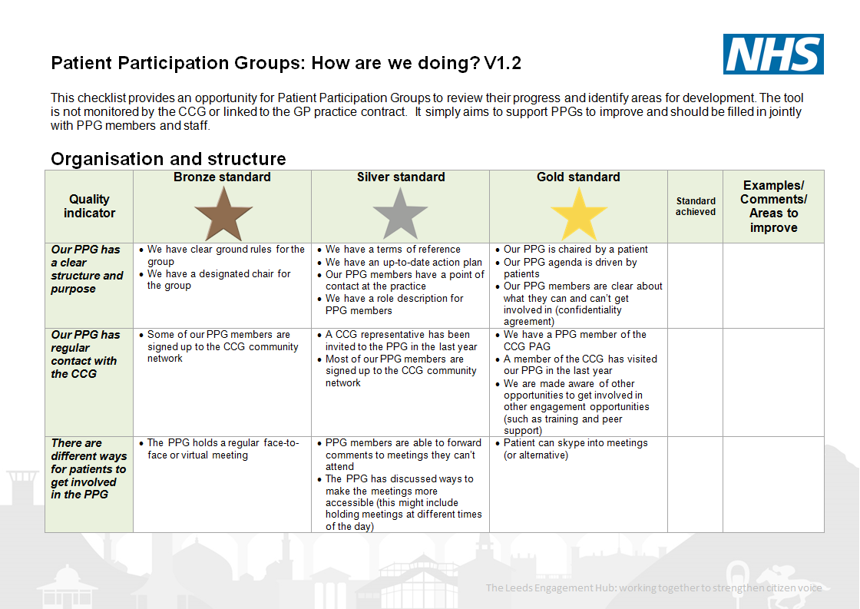
6. The role of the PPG in primary care
Tools to support PPGs
PPG quality indicator

Slide 40

6. The role of the PPG in primary care
Tools to support PPGs
Leeds patient champion programme
peer support
training
supervision

Slide 41

6. The role of the PPG in primary care
Tools to support PPGs
NHS Leeds patient involvement toolkit

Slide 42

6. The role of the PPG in primary care
Tools to support PPGs?
CCG community network

Slide 43

6. The role of the PPG in primary care
Tools to support PPGs?
CCG Engage magazine

Slide 44
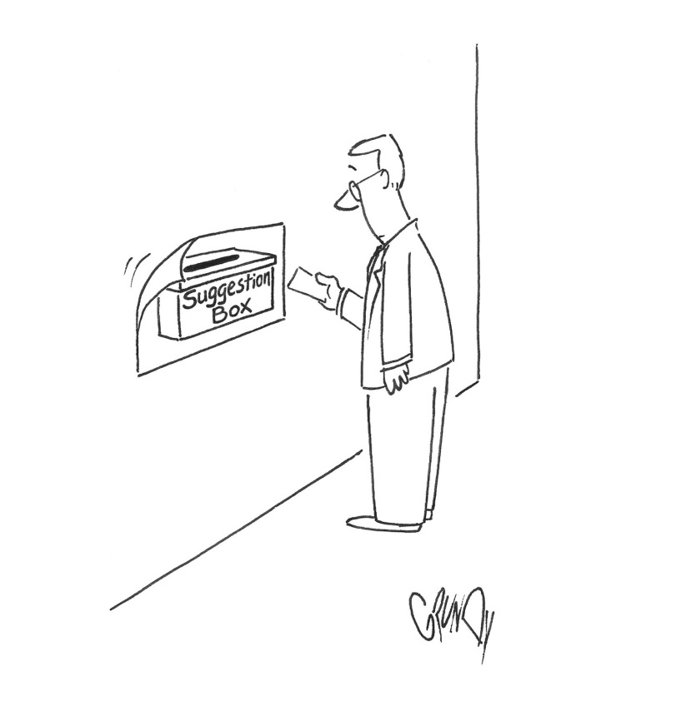
6. The role of the PPG in primary care
Tools to support PPGs?
GP practice complaints and compliments

Slide 45
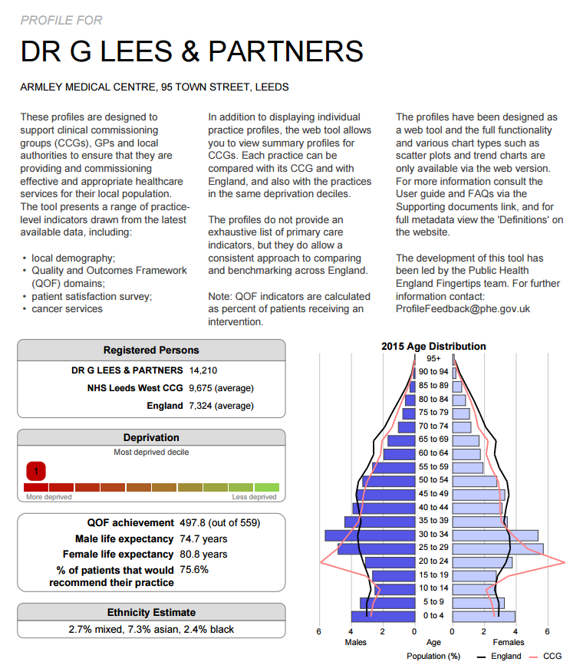
6. The role of the PPG in primary care
Tools to support PPGs
Public Health England
National General Practice Profile

Slide 46
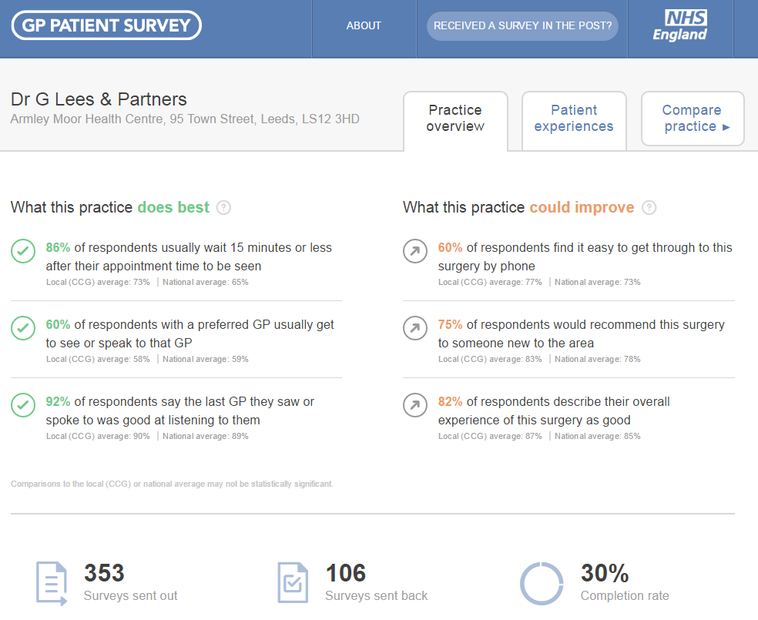
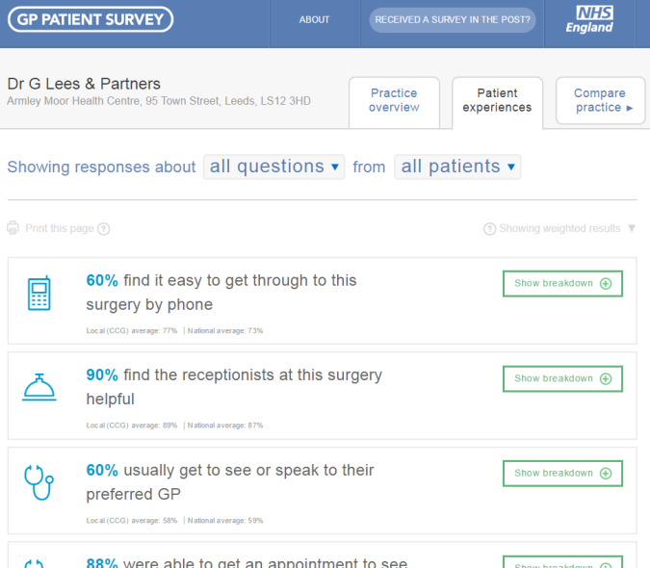
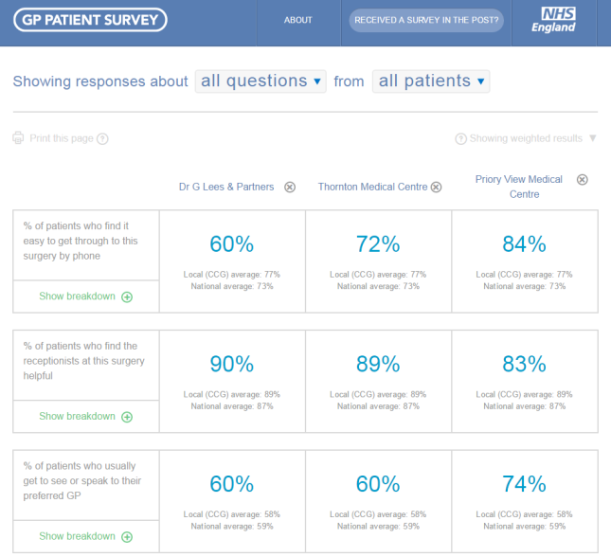
6. The role of the PPG in primary care
Tools to support PPGs?
NHS England
National GP patient survey
What the practice does best and what it could improve
What patients say about the practice
Compare your practice with others

Slide 47
6. The role of the PPG in primary care
Tools to support PPGs?
In small groups discuss how you might use these tools in your PPG

Slide 48


6. The role of the PPG in primary care
What other support is available to PPGs?
National Association of Patient Participation (NAPP)
The Patients Association

Slide 49
6. The role of the PPG in primary care
The activities of a PPG
Groupwork
What do you get up to in your PPG?
What else would you like to do?

Slide 50
6. The role of the PPG in primary care
The activities of a PPG
Help people to get online
Critical friend
Supporting engagement activities
Use skills to improve practice facilities (gardening)
Interviewing new staff
Fundraising
Contribute to a practice newsletter
Developing and delivering peer support groups
Champion the needs of vulnerable groups
Evaluate interventions

Slide 51
6. The role of the PPG in primary care
The activities of a PPG
Act as a critical friend to the practice
Speaking to patients and staff about changes
Gathering patient experience from patients
Interviewing for new staff
Support the analysis of patient feedback
Aid the development of peer support groups for patients
Use social media to promote the work of the practice/PPG
Attend local events as a representative of the practice
Seek the experience of ‘seldom heard’ groups who use the practice
Ensure that feedback from patients is heard and used by practices and commissioners
Write a newsletter
Support training for staff and patients
Write a press release to promote the PPG
Fill in the ‘gaps’ by signposting patient to more suitable services such as the voluntary sector
Mobilise volunteers to support isolation or help people get to the surgery
Fundraising to support interventions at the practice
Monitoring and evaluating the success of interventions
Improve practice facilities such as the waiting area or grounds
Hospital visiting, bereavement support, carer support
Organising a health fair
Developing and running creche facilities
Support people to use online services

Slide 52
6. The role of the PPG in primary care
The barriers and opportunities of your PPG
Groupwork
What holds back your PPG?
What has worked well in your PPG?
One recommendation

Slide 53
Session review
Patient champions champion the voice of the wider community
Commissioning is planning and paying for services
The CCG is responsible for ensuring GP practices are safe, effective and provide good patient experience
There are lots of challenges in primary care, especially the gap between resource and demand
The ‘Five Year Forward View’ introduces new models of care which aim to reduce barriers between care services an help service work better together
There are lots of different things happening in Leeds to improve primary care
In the future the CCG will become more involved in commissioning primary care (this is currently the responsibility of NHS England)
PPGs have an import role to play in developing primary care
Having a PPG is a contractual requirement of GP practices
There are lots of ways PPGs can influence health care in their community.

Slide 54
Useful contacts
Join our patient network | http://www.leedswestccg.nhs.uk/get-involved/how/join/
Find out about our patient champion programme | http://www.leedswestccg.nhs.uk/get-involved/how/patient-champion-programme/
Find out about our patient training | http://www.leedswestccg.nhs.uk/content/uploads/2015/07/Patient-champion-Calendar-2016-NEW.pdf
NHS Leeds West CCG Engagement Team | 0113 8435473 or chris.bridle@nhs.net
Access the PPG toolkit | http://www.leedswestccg.nhs.uk/content/uploads/2015/12/PPDES-Toolkit-FINAL.pdf
Read the Five Year Forward View | https://www.england.nhs.uk/ourwork/futurenhs/
National Association of Patient Participation | http://www.napp.org.uk/
The patients Association | http://www.patients-association.org.uk/
The National GP survey results | https://gp-patient.co.uk/
National GP profiles | http://fingertips.phe.org.uk/profile/general-practice/data

Slide 55

Questions

Slide 56

Session review - feedback
One thing you’ll take away from the session
Make a pledge

Slide 57
Evaluation and close
Please take five minutes to fill in our online evaluation of the session. You can find the survey here:
Please be honest so that we can improve the session.

